Slide 1
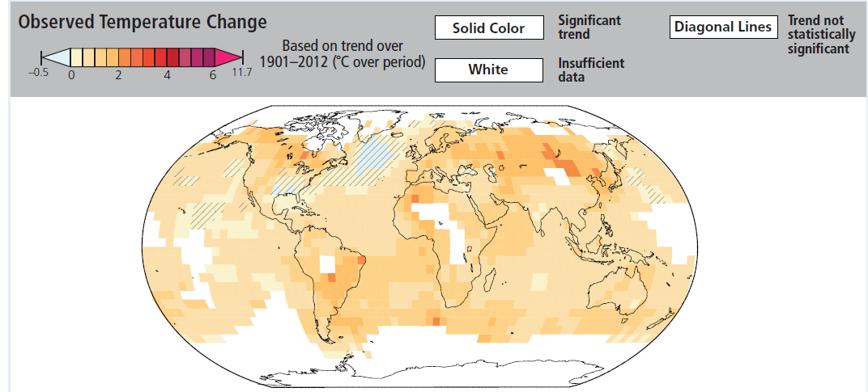
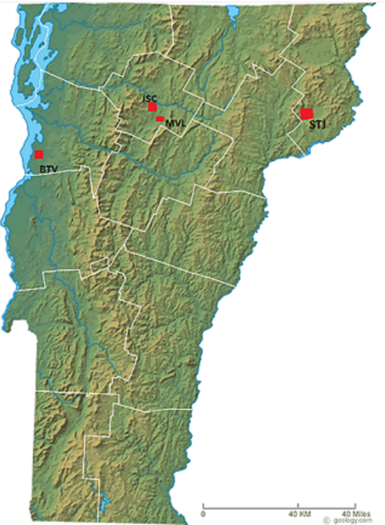
Detailed analysis of climate trends form the Northern Tier of Vermont from 2000-2014
Nasser Abdel-Fatah
Student: Johnson State College
Nasser Abdel-Fatah
Student: Johnson State College
Introduction
The various Intergovernmental Panel on Climate Change (IPCC) reports focused on global climate change scenarios. However, the general public are more concerned by local and regional changes that may develop within the global context (IPCC, 2014). Microclimate analyses allow an evaluation of what is happening in our region as it relates to the larger question of global changes. The purpose of this project was to evaluate weather data for the St. Johnsbury area (STJ) from 2000 to 2014. This data was processed into monthly, seasonal, and yearly data. Once this individual station evaluation was complete, the results were compared to other stations in the northern tier of Vermont: Johnson (JSC), Burlington (BTV), and Morrisville (MVL), (shown by the location map in Figure 1).
Results
Conclusion
Despite variations, an overall warming trend is noted over time for the St. Johnsbury station. This is also demonstrated by the other stations in the northern tier of Vermont. Additionally precipitation amounts appear to be on the increase. Trends have showed that years with higher amount of days with 1” or more precipitation, has the highest average temperatures. These results are consisted with the IPCC predictions (IPCC, 2014). With observed trends of more extreme weather in the near future, there needs to be a plan for high and low temperatures (see Figure. 6) and an overall increase in precipitation (IPCC, 2014).
Figure 3 shows the yearly temperature profile, (2000-2010), for St. Johnsbury. This graph highlights:
Years that have had high temperatures as well as years that have had very cold temperatures
The increase in average temperatures since 2000 can also be observed
Also noted are years of extreme high and low temperatures, being followed by a trend of warmer low temperatures and lower high temperatures
Materials and Methods
Weather statistics for the St. Johnsbury station were accessed from the National Climate Data Center (www.ncdc.noaa.gov). This data was compiled into different tables and graphs (hourly/daily, monthly, seasonal, and yearly data) using Microsoft Excel. The next part of this research focused on the comparison of processed weather data (compiled by previous RACC investigators) from three other stations: Burlington, Johnson, and Morrisville. Figure 2 shows a comparison data for the St. Johnsbury station for the month of February from 2000-2013.
Figure 3. Yearly Temperatures for STJ from 2000-2010.
Figure 4 shows the yearly summer precipitation profile across the four stations (2000-2010). This graph shows:
Across the four station BTV and MVL received the least amount of precipitation while, JSC and STJ had the greater precipitation totals
Overall, 2004 and 2008 had the greatest amount of precipitation
*these years also had the highest monthly averages, see the graph above*
Since 2000, there is a trend of increase precipitation totals for the summer season
Figure 6. Observed Temperature change. (IPCC, 2014).
Citations
Geology, 2015. Vermont Map Collection. Geology.com. Retrieved on February 2015, from: http://geology.com/state-map/vermont.shtml.
IPCC, 2014: Summary for policymakers. In: Climate Change 2014: Impacts, Adaptation, and Vulnerability. Part A: Global and Sectoral Aspects. Contribution of Working Group II to the Fifth Assessment Report of the Intergovernmental Panel on Climate Change [Field, C.B., V.R. Barros, D.J. Dokken, K.J. Mach, M.D. Mastrandrea, T.E. Bilir, M. Chatterjee, K.L. Ebi, Y.O. Estrada, R.C. Genova, B. Girma, E.S. Kissel, A.N. Levy, S. MacCracken,P.R. Mastrandrea, and L.L. White (eds.)]. Cambridge University Press, Cambridge, United Kingdom and New York, NY, USA, pp. 1-32.
Figure 4. 2000-2010 Summer Precipitation totals across all four stations.
Figure 5 shows precipitation comparisons for the four stations (2000,2010). This graph shows:
Years with the most days with precipitation over 1” had higher total precipitation overall
Following the years with higher precipitation totals, low precipitation can be observed, in the years 2000, 2004, and 2009
Across the four station the precipitation totals have shown an increase since 2000
Acknowledgments
I would like to thank Dr. Tania Bacchus for being my mentor through this process; providing me knowledge and support to do this project. Thank you to Laurence Hayes, the Fairbanks Museum, the National Climate Data Center, Ashley Fortin and Brittany McCarthy for providing me with information to complete this project. And Thank you RACC, CWDD and the NSF for there funding of this project.
For further information please contact:
Nasser.Abdel-Fatah@jsc.edu or:
Tania.Bacchus@jsc.edu
Year
Figure 1. Image of Vermont with location of each weather station compared. (Geology, 2015).
Figure 2. Comparison of STJ from 2000-2013, showing both Temperature and Precipitation Totals for February.
Figure 5. 2000-2010 Precipitation comparisons across all four stations.
Funding provided by NSF Grant EPS-1101317
Notes:
Copyright Colin Purrington (http://colinpurrington.com/tips/academic/posterdesign).

