Slide 1
Effects of Riparian Buffers on Nitrogen, Phosphorus, and Total Suspended Solids
Kaylee C. Jackson

Slide 2
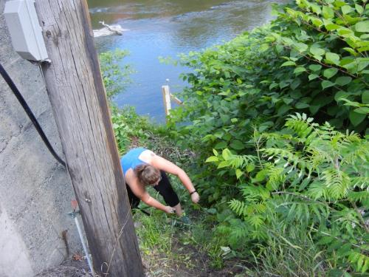
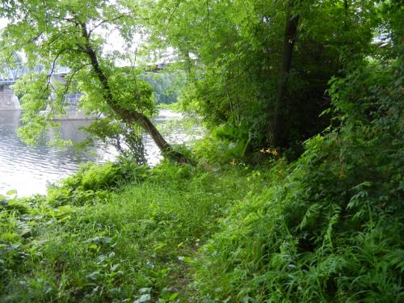
Introduction
Flow of nutrients increases eutrophication
Riparian buffers often used to help absorb excess nutrients
Buffers also provide stabilizing factor
Composition plays an important role
Soil type, slope and land use

Slide 3
In this study, I am examining the width of riparian buffer zones in agricultural sites along both the Missisquoi and Winooski rivers, and showing how those buffers affect the amount of phosphorus, nitrogen and total suspended solids found in those watersheds between 2013 and 2015
Hypothesis

Slide 4
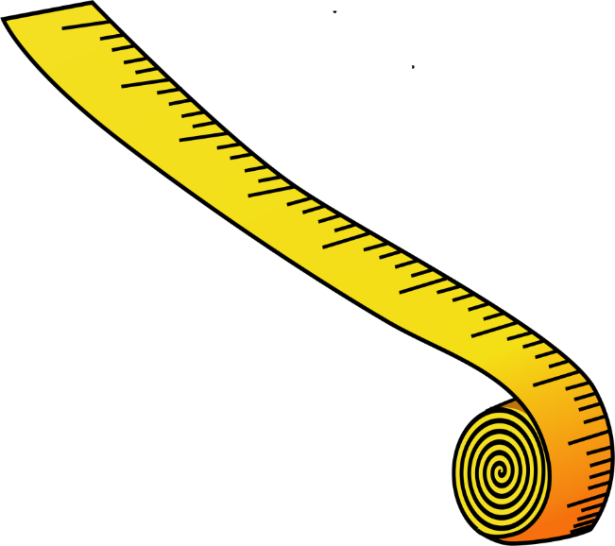
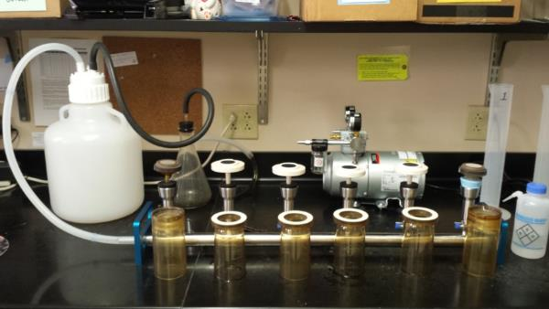
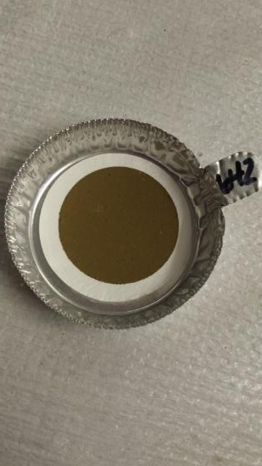
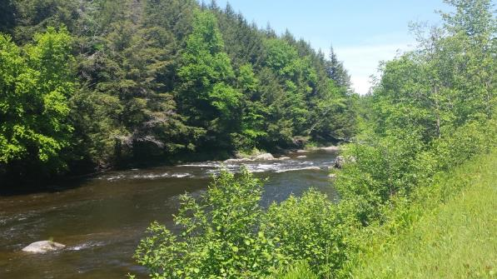
Materials and Methods
Buffers
Composition
TSS
Nitrogen
Phosphorus

Slide 5
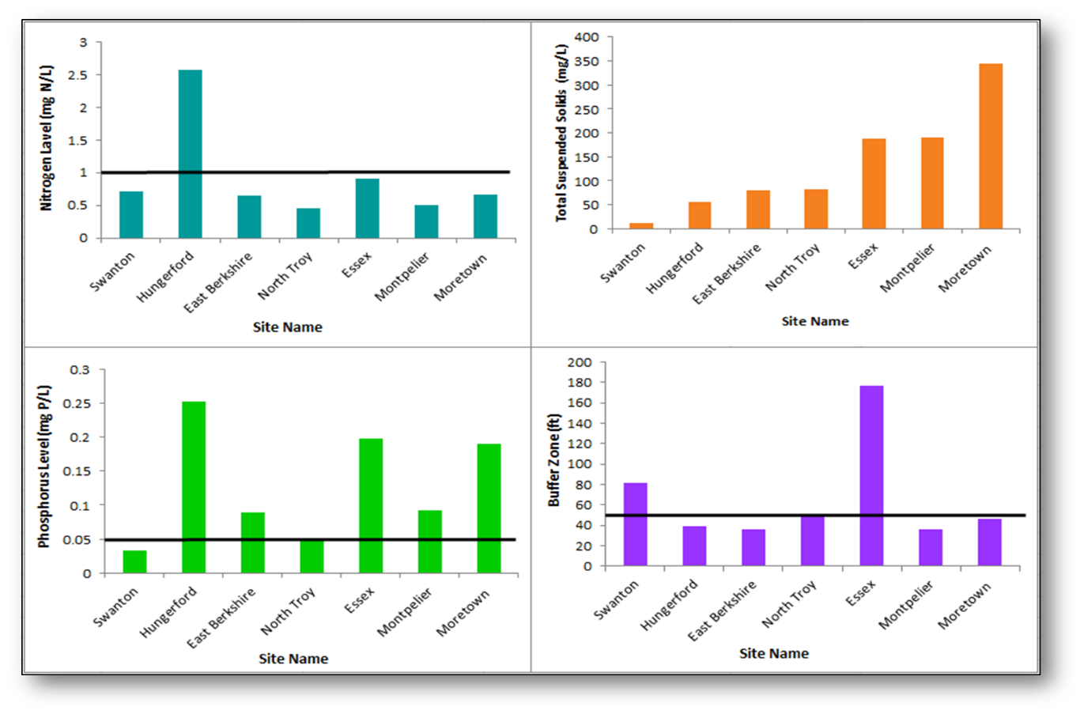
Results 2013
Figure 1. Comparison of Nitrogen, Phosphorus, Total Suspended Solids (TSS) and Buffer Zone width in 2013 for various sites throughout the Missisquoi and Winooski watersheds. The black line on phosphorus and nitrogen graphs represent the maximum recommended amount of that nutrient, and the black line on the buffer zone graph represents the minimum effective buffer width.

Slide 6
Results 2014
Figure 2. Comparison of Nitrogen, Phosphorus, Total Suspended Solids (TSS) and Buffer Zone width in 2014 for various sites throughout the Missisquoi and Winooski watersheds. The black line on phosphorus and nitrogen graphs represent the maximum recommended amount of that nutrient, and the black line on the buffer zone graph represents the minimum effective buffer width.

Slide 7
Results 2015
Figure 3. Comparison of Nitrogen, Phosphorus, Total Suspended Solids (TSS) and Buffer Zone width in 2015 for various sites throughout the Missisquoi and Winooski watersheds. The black line on phosphorus and nitrogen graphs represent the maximum recommended amount of that nutrient, and the black line on the buffer zone graph represents the minimum effective buffer width.

Slide 8
Discussion
Hypothesis supported
Decreased riparian diversity was not beneficial to water quality
Wide, mixed-composition riparian buffer zones and reduced fertilizer application are good ways to reduce the amount of nutrient runoff

Slide 9
Acknowledgements
I’d like to thank Saint Michael’s College for providing lab space and NSF Grant EPS1101317, without whose funding this research would not be possible. Also a huge thank you to my amazing coworkers, Mariah Witas, Nate Dooley and Elise Prehoda for making this summer so fun. Lastly, thank you to Janel Roberge and Declan McCabe for supporting my research.

Slide 10
Literature Cited
Astudillo, M. R., Novelo-Gutierrez, R., Vazquez, G., Garcia-Franco, J. G., Ramirez, A. 2016. Relationships between land cover, riparian vegetation, stream characteristics, and aquatic insects in cloud forest streams, Mexico. Hydrobiologia, vol. 768, pp. 167-181.
Clinton, B. D. 2011. Stream water responses to timber harvest: Riparian buffer width effectiveness. Forest Ecology and Management, vol. 261 pp. 979-988.
Connolly, N. M., Pearson, R. G., Loong, D., Maughan, M., Brodie, J. 2015. Water quality variation along streams with similar agricultural development but contrasting riparian vegetation. Agriculture, Ecosystems and Environment, vol. 213, pp. 11-20.
Hawes, E.. and Smith, M. 2005. Riparian Buffer Zones: Functions and Recommended Widths. Yale School of Forestry and Environmental Studies, pp. 1-13.
Klapproth, J.C. and Johnson, J.E. 2009. Understanding the science behind riparian forest buffers: effects on water quality. Virginia Cooperative Extension, pp. 1-21.
Newbold, J. D., Herbert, S., Sweeney, B. W., Kiry, P., Alberts, S. J. 2010. Water Quality Functions of a 15-Year-Old Riparian Forest Buffer System. Journal of the American Water Resources Association, vol. 46, pp. 299-309.
River Keepers. Cited 2016 June 24. The Importance of Healthy Riparian Zones. Available from: http://www.riverkeepers.org/

Slide 11
Questions?

