Slide 1
Correlation of Macroinvertebrates with Watershed Characteristics
Emily Lucie, Tony Wang, Scott Worland

Slide 2
Introduction
The perturbation theory suggests that increasing levels of human disruption to natural habitats will result in changes to the composition of the macroinvertebrate community.
EPT & HBI
The River Continuum Theory predicts a change in feeding groups based on elevation and a transition to higher order rivers.
Our analysis made use of the entirety of the macroinvertebrate data available from EPSCoR and tested its viability in the geographic area of Lake Champlain Basin.
Research Question - How does EPSCoR data regarding macroinvertebrate agree with the perturbation theory and river continuum concept?

Slide 3
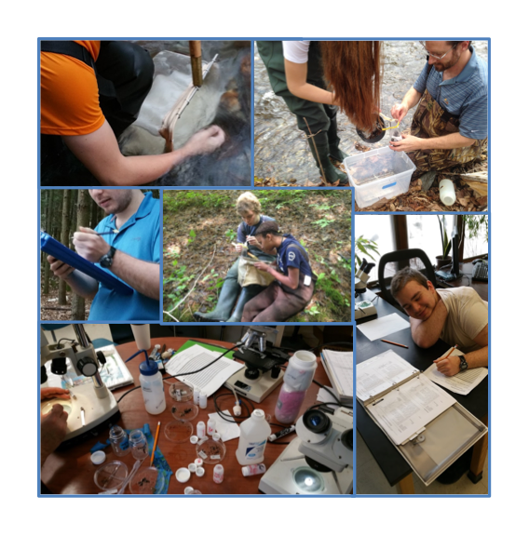
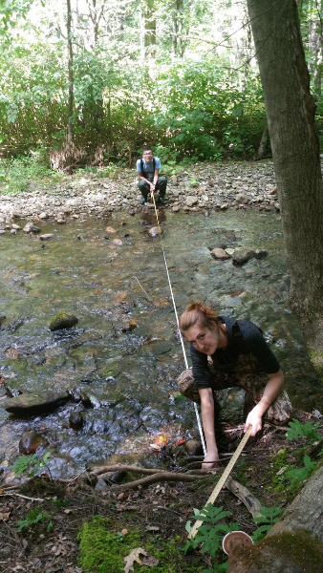
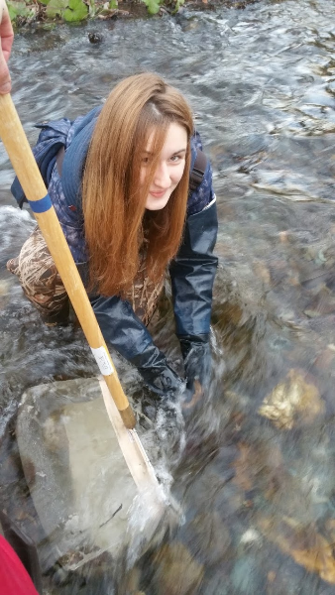
Notes:
Here are some photos of us collecting data and identifying invertebrates as many of you have done throughout the state to contribute to the database.

Slide 4
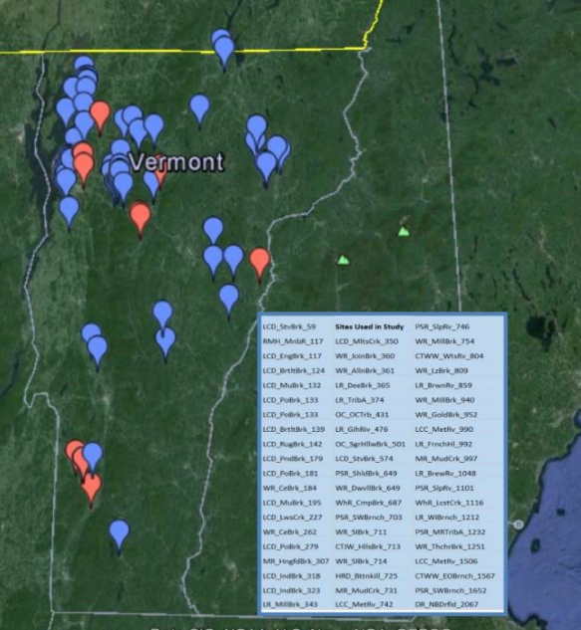
Methods
Downloaded the available macroinvertebrate data from the EPSCoR database.
Obtained the geographic information about the sites from GIS database
Used spreadsheets to organize the data according to site code and elevation.
Only included data from sites with more than 4 replicates from a given site.
Developed and applied various metric calculators to all these sites, which gave results in the form of index values (EPT, HBI, % feeding group)
Correlational graphs were produced using Vernier Logger Pro.
Notes:
(Emily)
First we downloaded the available macroinvertebrate data from the EPSCoR database.
We were given the geographic information on each site from the GIS database.
Next, we used spreadsheets to organize the data according to site code and elevation
We only included sites which had more than 4 replicates.
We developed and applied our metrics calculator to all of these sites, which gave us EPT, HBI, and % Feeding group values.
To further organize our data, we used correlational graphs produced using Vernier Logger Pro

Slide 5
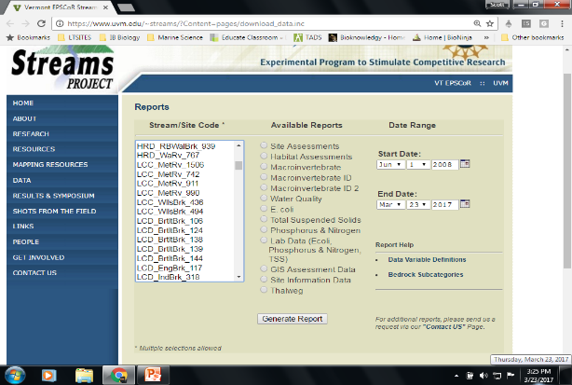
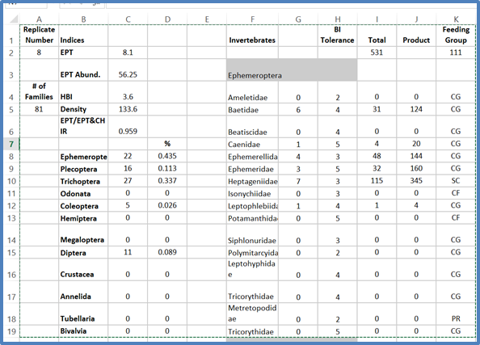
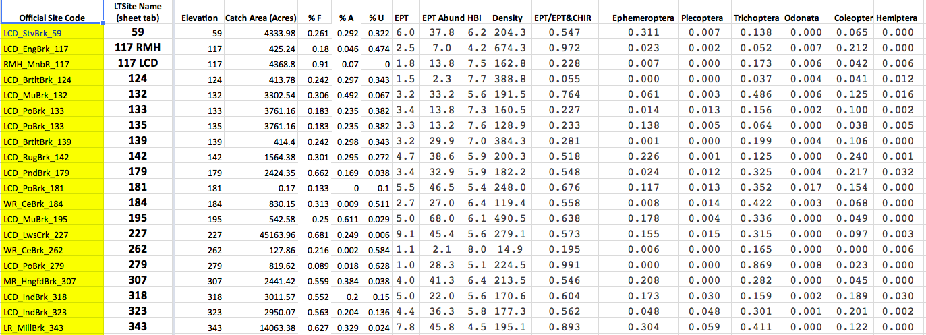
Online Database
Custom Metrics Calculator for Each Site
Summary Table with Calculated Metrics for all Sites.
Notes:
(Emily)
Online Database- here's an example of the online database, from which we downloaded all of the invertebrate information.
Custom Metrics Calc- Next is an example of the metrics calculator which we applied to each site in order to calculate water quality indices and feeding group designations for further analysis.
Summary Chart- This drew from EACH analyzed site, and paired it with GIS data for correlation analysis. %forested, ag, urban, etc.

Slide 6
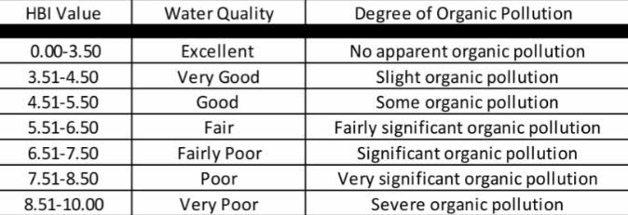
Biotic Indices
HBI: Hilsenhoff Biotic Index is an estimation of the overall pollution tolerance level of macroinvertebrates in an area. Higher levels of human disturbance correlate with higher HBI values.
EPT: Richness and diversity index that is determined by the average number of families within the Ephemeroptera, Plecoptera, and Trichoptera orders from a sample. This index tends to be higher in less impacted stream systems.
Notes:
(Emily)
Like we mentioned earlier, we analyzed our data according to HBI and EPT values.
HBI is an indication of the abundance of insects based on their pollution tolerance. Higher values should correlate to more impacted streams.
EPT is a richness index. This index should increase as water quality improves.

Slide 7
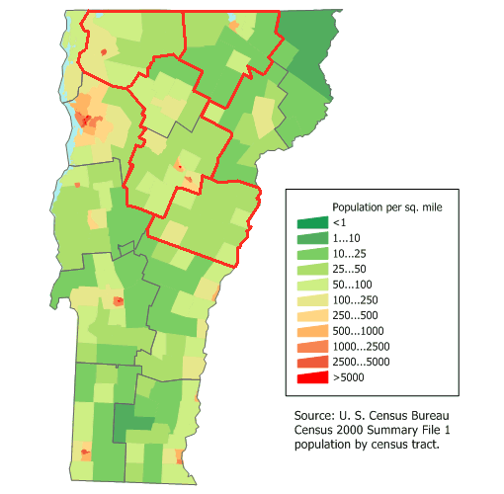
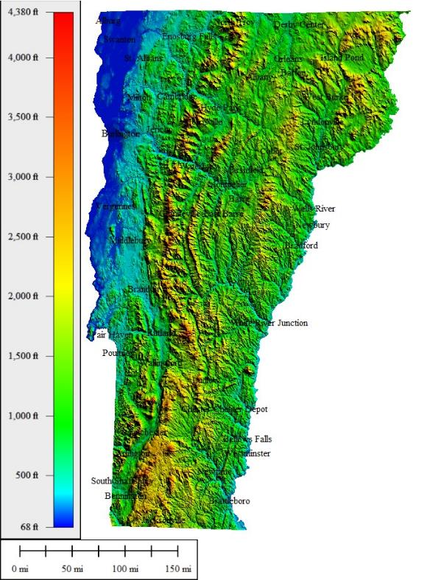
Notes:
(Emily)
On the left we have a population map of vermont, on the right is elevation. Generally, as elevation increases, population decreases.

Slide 8
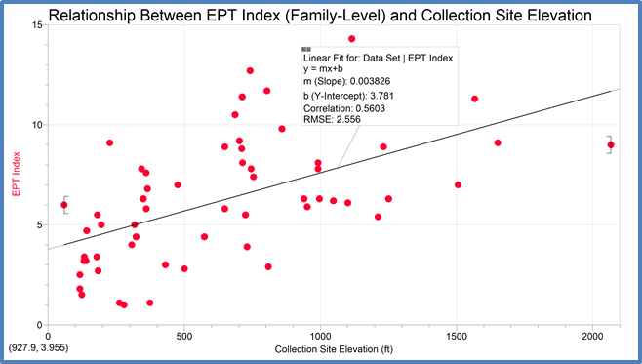
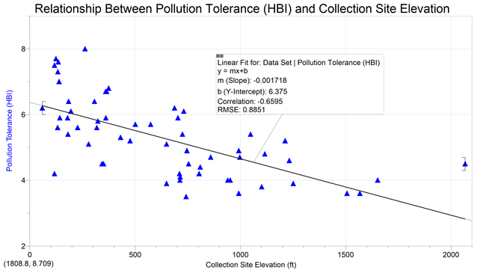
Results: Water Quality Indices vs Elevation
EPT vs Elevation (r=0.56) ✓
HBI vs Elevation (r= -0.66) ✓
Notes:
Our analysis confirmed that as elevation increases, EPT index also increases with less human disturbance across the state. As we predicted, HBI is negatively correlated to elevation. Lower elevations with more human activity results in more pollution tolerant species found in the river.

Slide 9
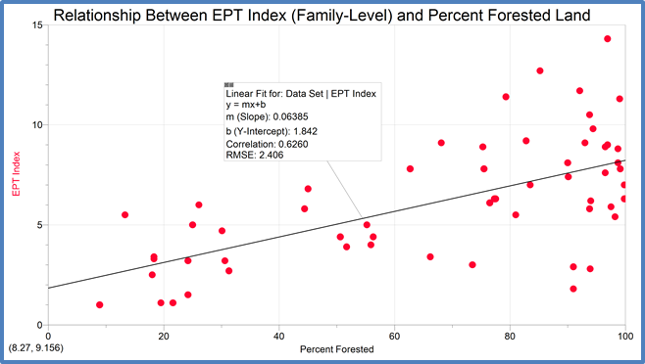
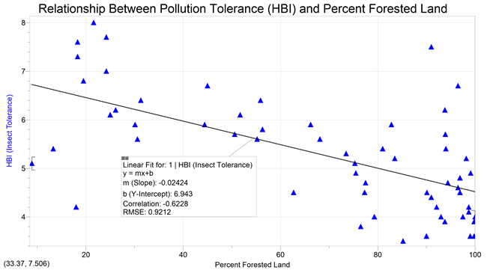
Water Quality Indices vs % Forested Land
In general, the more forest there is, the more diversity there is. The EPT index is most strongly correlated with forestest land.
EPT vs % Forested (r=0.63) ✓
HBI vs % Forested (r= -0.62) ✓
Notes:
(Emily) The amount of forested land above the sample site also correlates positively to EPT index. There is an expected negative correlation between % of forested land and HBI.

Slide 10
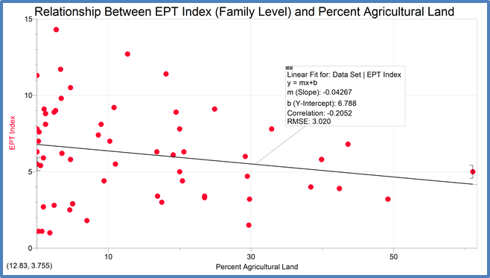
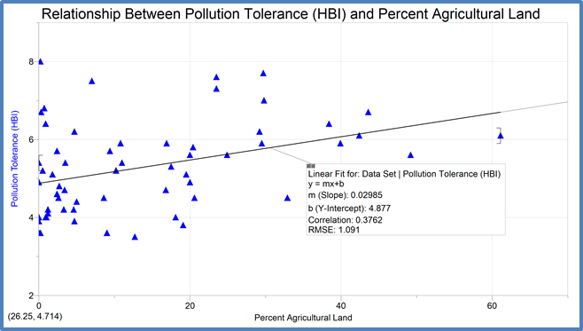
Water Quality Indices vs % Agricultural Land
EPT vs % Agricultural (r=-0.2)
HBI vs % Agriculture (r= 0.38)
Notes:
As the amount of land above the collection site used for agricultural purposes increases, the EPT index predictably decreases, though not as strongly as expected. HBI also tracks as expected, but not as strongly as we anticipated.

Slide 11
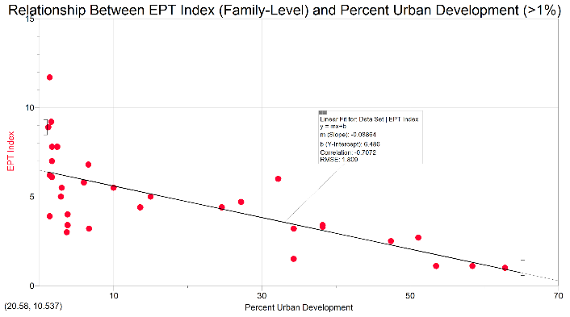
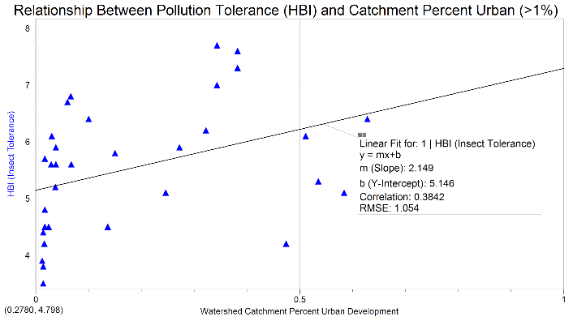
Water Quality Indices vs % Urban Development
A negative correlation exists between percent urban land and EPT index. Therefore, there is less diversity in urban areas.
EPT vs % Urban (r=-0.62)
HBI vs % Urban (r= 0.38)
Notes:
Percent urban development had very strong negative correlation to the EPT richness index. As the % urban development increases, the HBI does as well- though much variability exists.

Slide 12
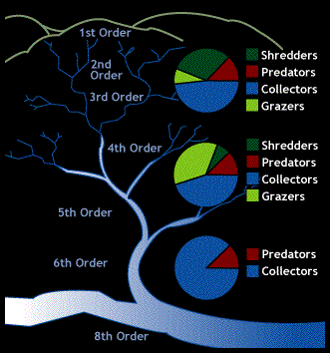
River Continuum Theory
River continuum concept: A conceptual model of how physical characteristics of a stream at different orders affect the composition of functional feeding group.

Slide 13
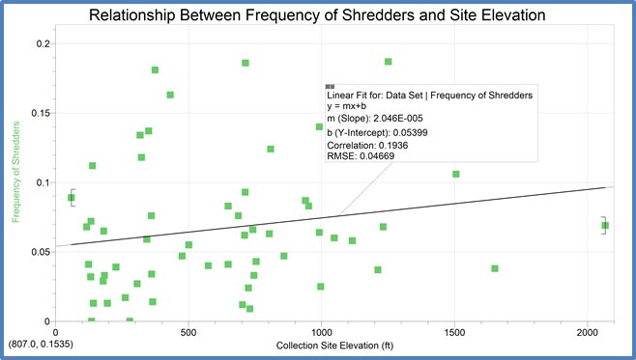
Shredders vs Elevation
R = 0.19
Notes:
Agrees despite weak correlation

Slide 14
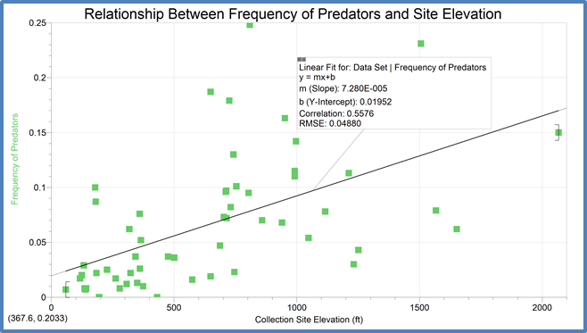
Predators vs Elevation
R = 0.56
Notes:
Shouldn’t show a noticable difference.

Slide 15
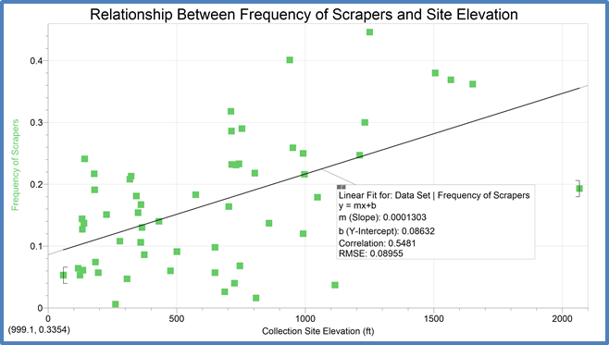
Scrapers/Grazer vs Elevation
R = 0.55
Notes:
Should be Bell shape
The difference of canopy coverage between medium-low and high elevation in Vermont isn’t big enough to support a drop of scrapper population.

Slide 16
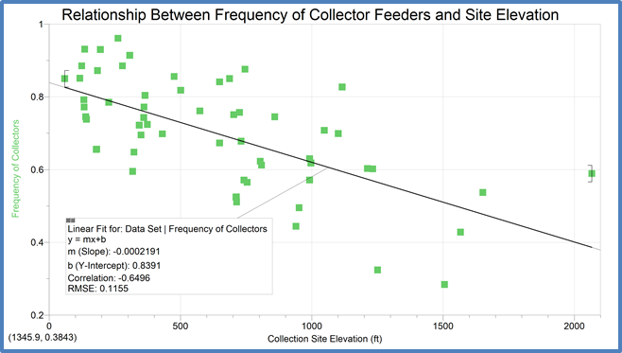
Collector vs Elevation
R = -0.65
Notes:
As predicted

Slide 17
Discussion
Strong Correlation in support of the theory | Weak Correlation in support of the theory | Unpredicted Outcomes
WQ vs Elevation WQ vs % Forested EPT % vs Urban Collectors vs Elevation | WQ vs % Agricultural HBI vs % Urban Shredder vs Elevation | Predator vs Elevation Scraper/Grazer vs Elevation
Notes:
6/12
Empirical data agrees with perturbation theory more than it does to RCC.
The assumption that site elevation could indicate the order of the river at the site is untenable.
The RCC prediction is based on the pattern of energy transmission featuring the stream at different orders. Energy is stored in the manner of biomass. The research should therefore use biomass data instead of richness data which is supplied by Epscor database.
Feeding group also varies in relation to human perturbation, of which elevation has been established as an indicator.

Slide 18
Conclusion
The result of our research generally agrees with the predominant river theory.
Citizen science projects enable professionals to garner sufficiently accurate data in scales impossible for traditional studies.
Recommendation for Further Research
Continue adding the latest data to the correlational analysis.
Analyze macroinvertebrate group composition in light of water chemistry data.
Notes:
As EPSCoR project gathers more data throughout the year. The latest data could be added to the viability analysis.
Since water chemistry data also forms part of the database, they could be used in place of macroinvertebrate data to test the human impact on the environment.

Slide 19
References
Vannote et al. 1980; Minshall et al. 1985). Vannote, Robin L, G. Wayne Minshall, Kenneth W. Cummins, James R. Sedell, and Cobert E. Cushing. “The River Continuum Concept” Can. J. Fish. Aquat. Sci. 37 (1980) 130-137.
Barbour et al. 1999 Barbour, M.T., J. Gerritsen, B.D. Snyder, and J.B. Stribling. (1999) Rapid Bioassessment Protocols for Use in Streams and Wadeable Rivers: Periphyton, Benthic Macroinvertebrates and Fish, Second Edition. EPA 841-B-99-002. U.S. Environmental Protection Agency; Office of Water; Washington, D.C.
Hilsenhoff, W.L. 1987. An improved biotic index of organic stream pollution. Great Lakes Entomologist 20: 31-39.
https://sites.google.com/site/mapitoutmansfield/topographic-maps
https://www.nps.gov/olym/learn/education/upload/Functional-Feeding-Groups.pdf

Slide 20
Thank You!

