Slide 1
The Effect of High Flow Events on N:P Ratio within the Missisquoi and Winooski Tributaries
Amanda Keilty
Chelsea Cole
Daniel Wilkinson
Robert Genter, Ph.D. and Saul Blocher

Slide 2
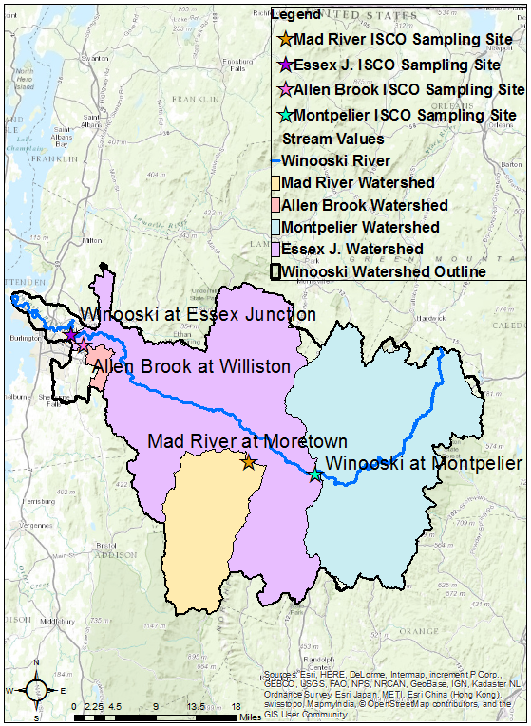
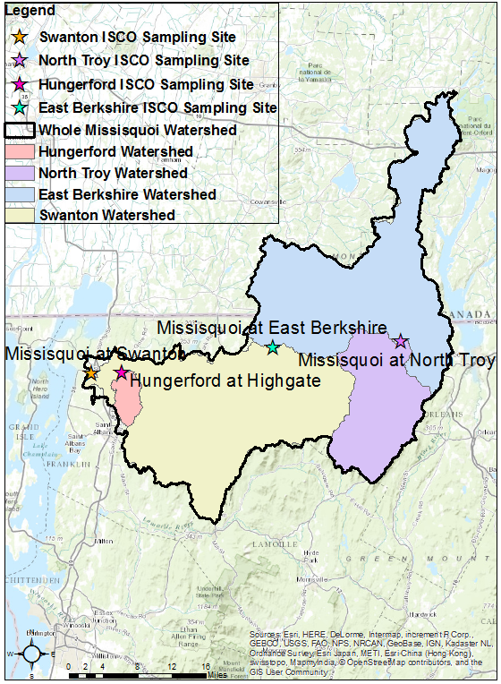
Methods
TN and TP
ISCOs
2012-2015
Geographic
Information
Systems (GIS)

Slide 3
“Urban” Watershed
Agricultural Watershed

Slide 4
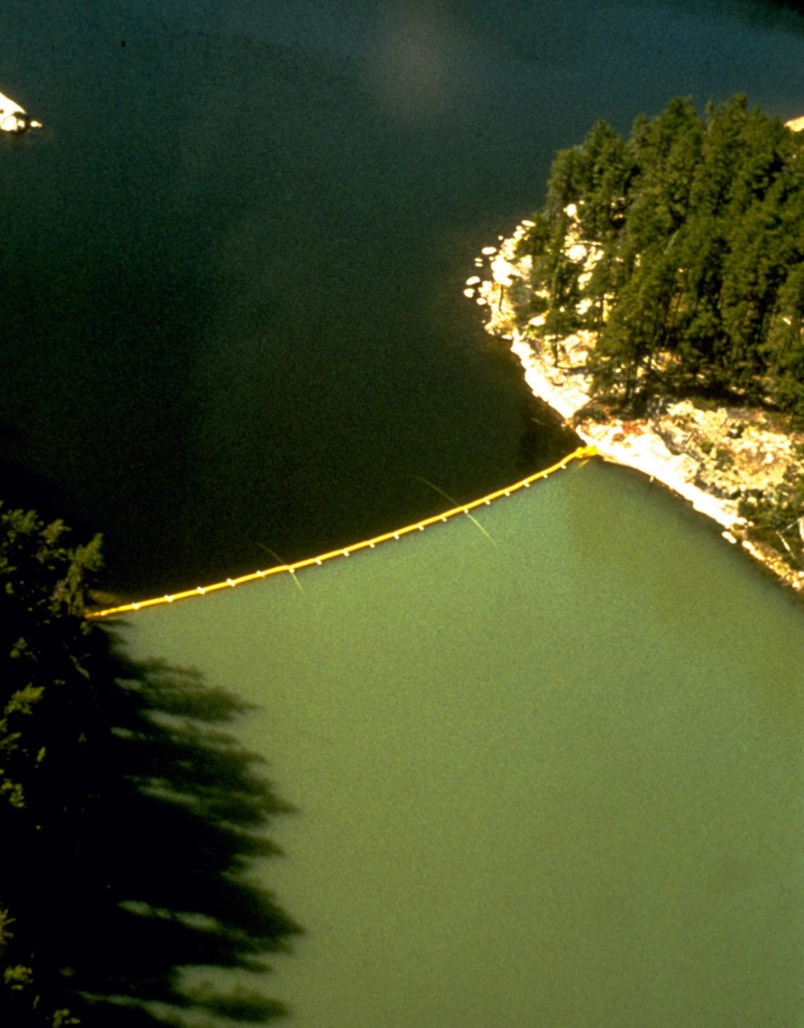
Schindler’s Experiment: Lake 226
N + C
Leibig’s Law of the Minimum
P + N + C
https://www.google.com/search?q=schindler%27s+canadian+lake&espv=2&biw=1920&bih=979&source=lnms&tbm=isch&sa=X&ved=0ahUKEwj6--b7kfPNAhWH9x4KHRjEDU4Q_AUIBigB#imgrc=j0_Wi2BRNaYNMM%3A

Slide 5
Research Questions
 | Do concentrations change during high flow? | Do concentrations change related to land use?
N
P
N:P
What are possible implications of any changes?

Slide 6
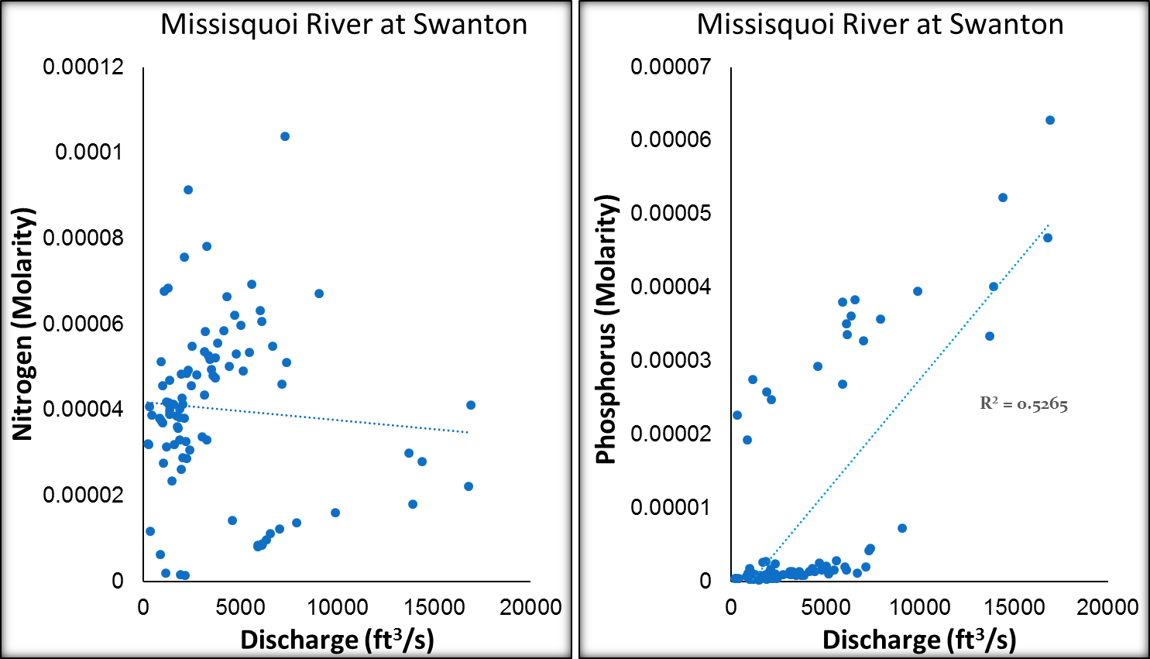
N & P with Discharge

Slide 7
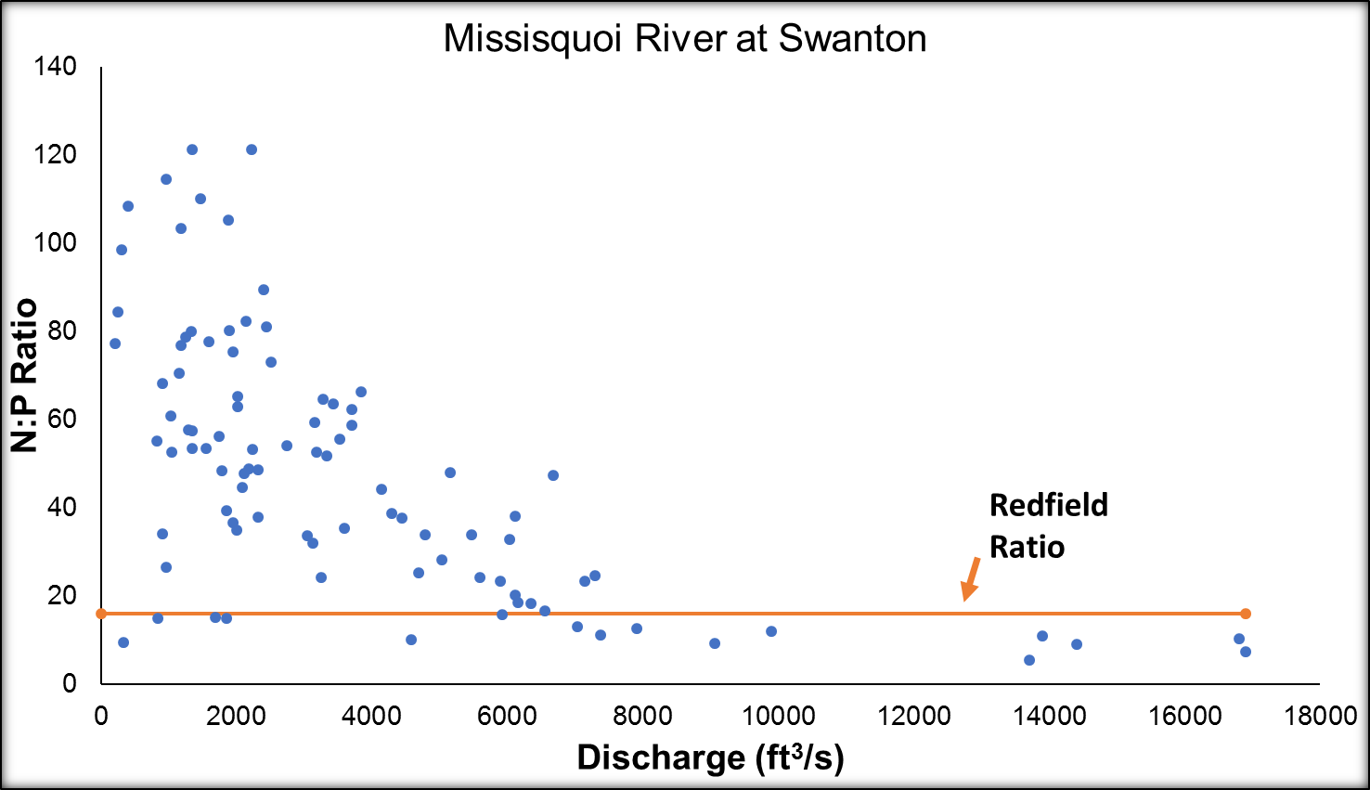
N:P with Discharge

Slide 8
Research Questions
 | Do concentrations change during high flow? | Do concentrations change related to land use?
N | No
P | Increase
N:P | N:P decrease, Variation decrease
What are possible implications of any changes?

Slide 10
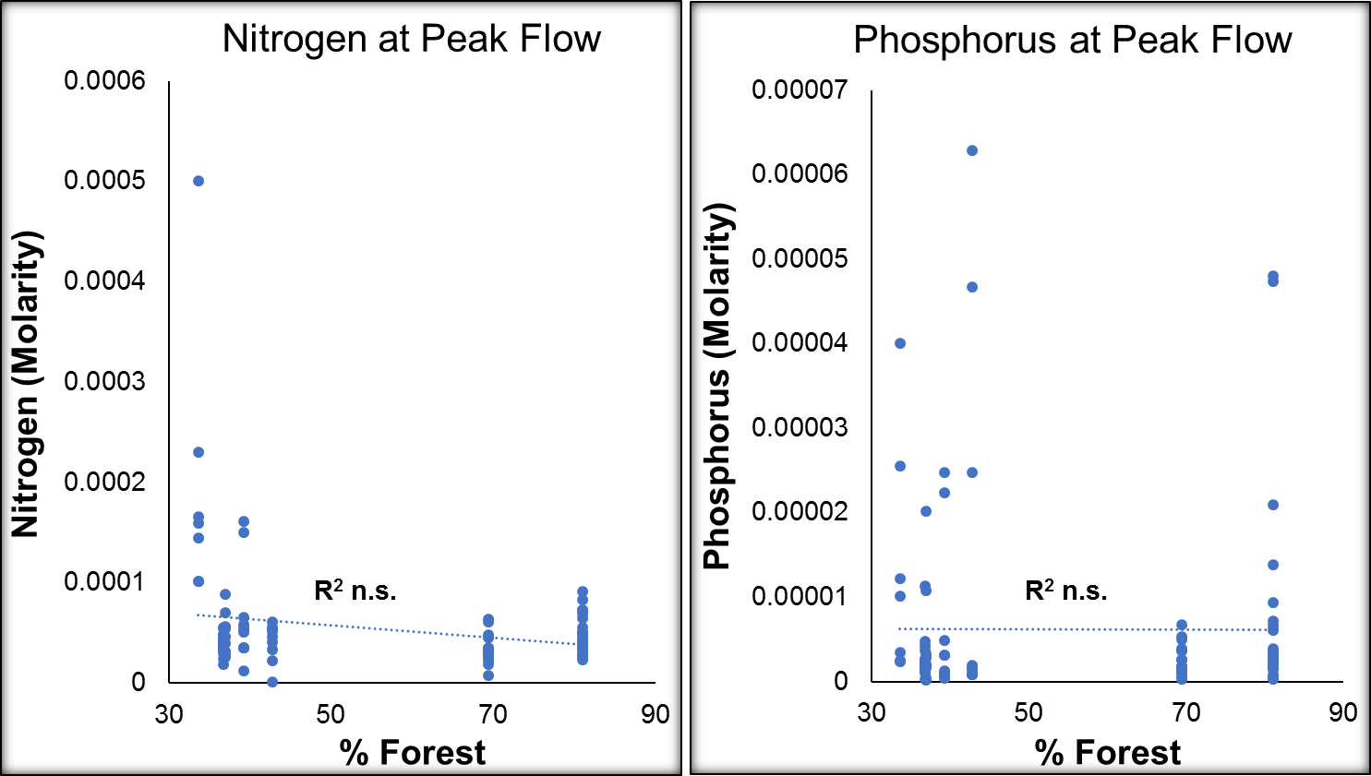
N & P with Land Use

Slide 11
N:P with Land Use

Slide 12
Research Questions
 | Do concentrations change during high flow? | Do concentrations change related to land use?
N | No | No
P | Increase | No
N:P | N:P decrease, Variation decrease | No
What are possible implications of any changes?

Slide 13
Fairchild, Lowe, & Richardson (1985)
Anabaena sp.
Epithemia adnate
Rhopalodia gibba
Achnanthidium minutissima
Gomphonema tenellum
Cocconeis placentula
Stigeoclonium tenue
Naviculoids
Anabaena is N-fixing;
Epithemia and Rhopalodia have N-fixing endosymbiotic algae
= Low N:P
N
N+P
P

Slide 14
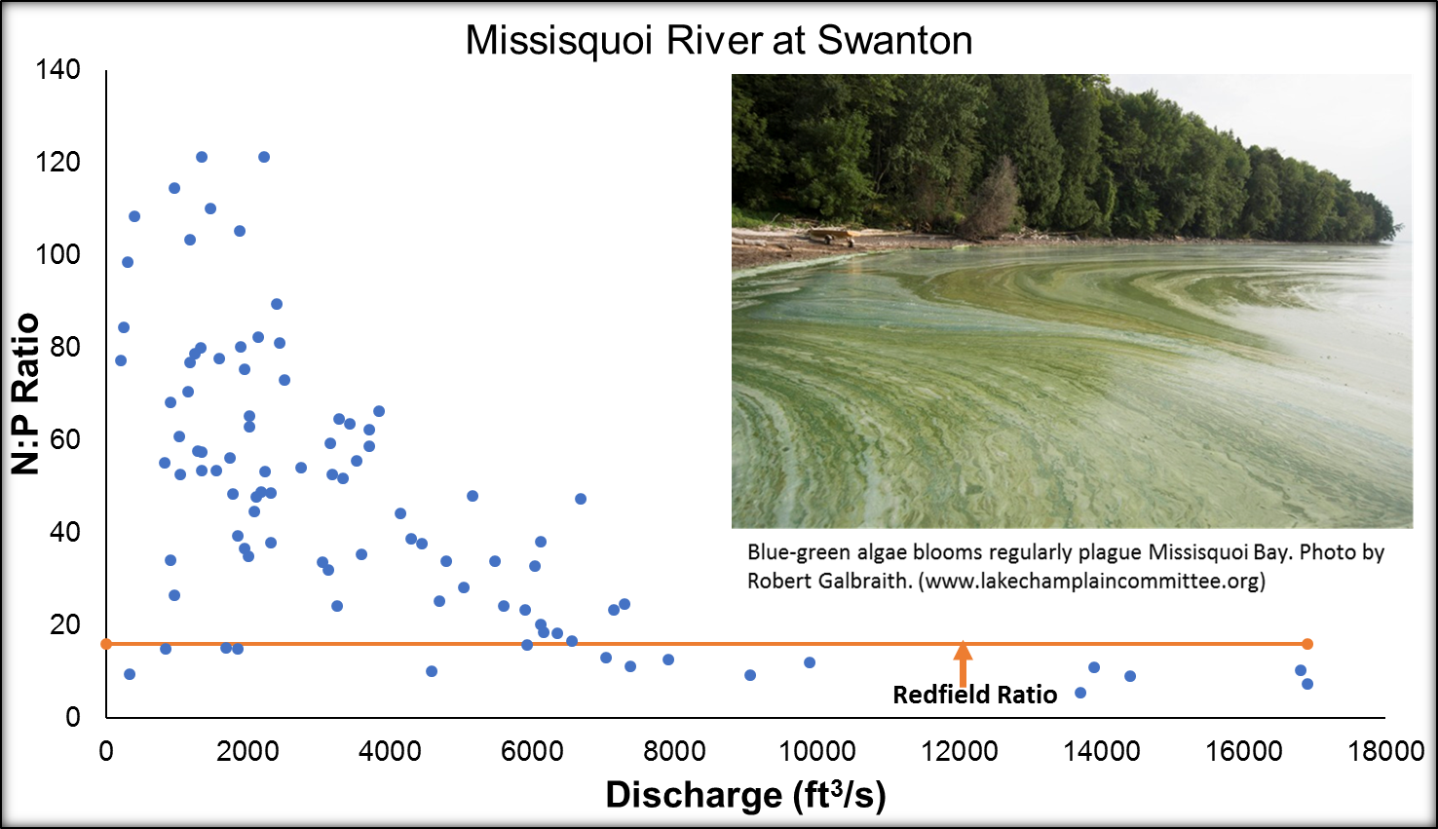
Redfield Ratio, 16N: 1P molar

Slide 15
Thank you

Slide 16
Citations
Fairchild, GW, RL Lowe, & WB Richardson. 1985. Algal periphyton growth on nutrient-diffusing substrates: An in-situ bioassay. Ecology 66(2): 465-472.
University of Vermont Spatial Analysis Lab, 2007. Land Use/Land Cover for the Lake Champlain Basic, Circa 2001. Burlington, Vermont 3: 1-11.
Vermont Center for Geographic Information, Inc., United States Geological Survey (USGS), EROS Data Center, 2002. ElevationDEM_DEM24. Sioux Falls, South Dakota 2002: 1-6.
Funding provided by NSF Grant EPS 1101317

Slide 17
Just in Case

Slide 18
Just in Case Part 2

Slide 19
Our focus was simple “single peak” hydrograph events.

Slide 26
Missisquoi Basin and Sub-basins

Slide 27
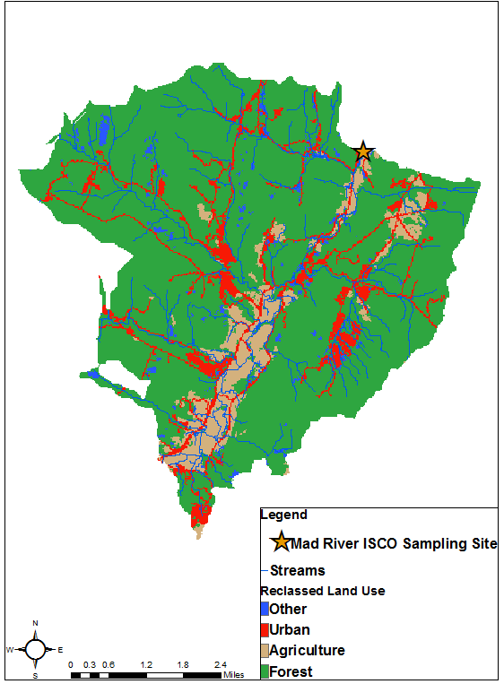
Mad River Focus Area

Slide 29
4 Watersheds in the Winooski Basin

