Slide 1
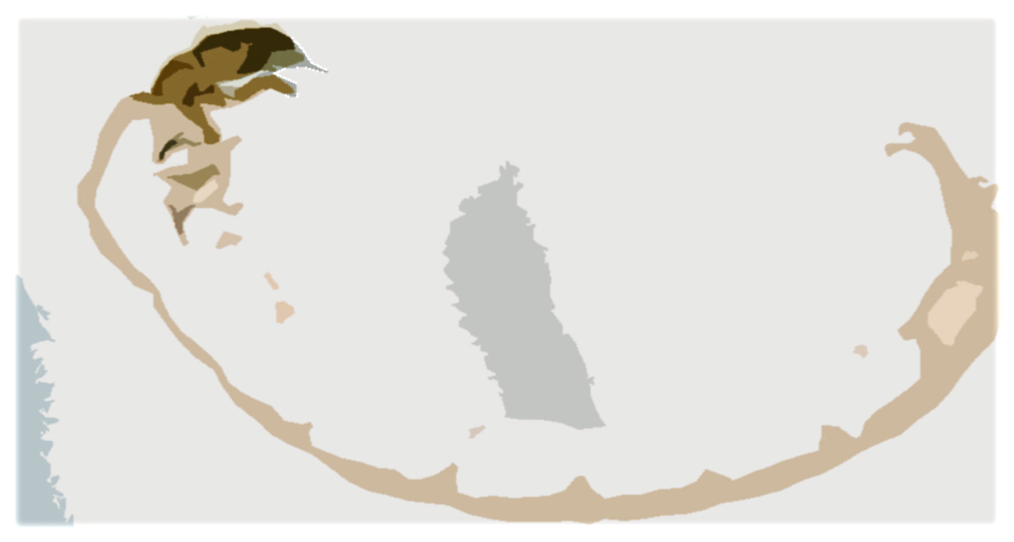
Effects of agricultural activities on physico-chemical parameters and benthic macroarthropods
By: Darissy Matías Serrano & Alana V. Quiles Trinidad
Prof. Rose M. Trinidad
Juan Ponce de León High School
Florida, Puerto Rico
Notes:
Saludo
Names
Research: Effects of agricultural activities on physico-chemical parameters and benthic macroarthropods

Slide 2
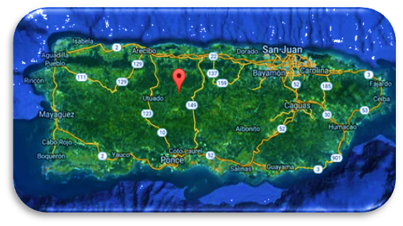
Background
Study Areas
Notes:
We conducted our study in the mountains of the northern-central zone of Puerto Rico, in rio Yunes River in Ciales and Limon River in Utuado, PR.

Slide 3
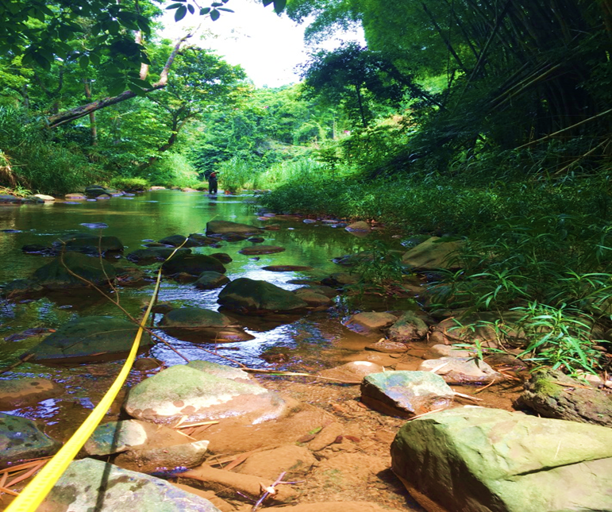
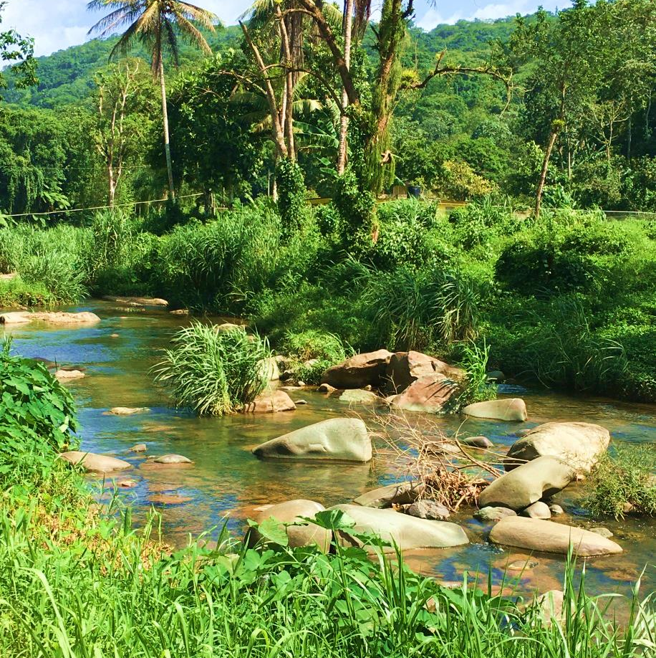
Yunes River Limon River
Problem:
How anthropogenic activities affect nutrients and macroarthropods families in a tropical stream?
Notes:
The zone is classified as sub-tropical moist forest. Both research areas are surrounded by agricultural land use. In Yunes River the stream flows between a coffee plantation and banana plantation, banks are dominated by bamboo trees. At Limon river some domestic animals reach the stream (pigs, sheep, goat) little banana crops are there. Riparian vegetation consists of grasses near the channel margin. Our Problem statement was: How anthropogenic activities affect nutrients and macroarthropods families in a tropical stream?

Slide 4
Hypothesis
The intensity of agricultural activity near river banks will increase nutrients concentrations, so the benthic macroarthropod’s diversity will decrease.
Notes:
Our Hypothesis was: The intensity of agricultural activity near river banks will increase nutrients concentrations, so the benthic macroarthropod’s diversity will decrease.
Based on research made in Costa Rica, changes in nutrients concentrations caused by agricultural activities, affect the diversity of macroarthropods.

Slide 5
Methodology
Samplings
Classification
Parameters
Notes:
Our research focused on the measurement and analysis of physico-chemical parameters on the community of aquatic macroarthropods from August to November 2016. We delimited sites of 25m upstream and 25m downstream in each river. Sampling sites are impacted by agricultural activities to a lesser degree and greater extent. Streams were characterized in terms of chemistry parameters, habitat assessment, and macroinvertebrate community. Four samplings were carried out with 3 replications per sample for chemical parameters. We measured pH, dissolved oxygen, temperature, conductivity and turbidity in situ using CHEMETS kits and OAKTON PCS TESTER-35. On each occasion phosphates, nitrogen, dissolved solids, OD, ammonia, pH, conductivity and salinity were measured. Water analysis was conduced at UVM. We measured and calculated physical parameters as: reach, depth, and velocity. Turbidity was measured using Secchi tube and estimated in NTU. Macroinvertebrates were collected in the first date and in the last date of sampling. We collected in three riffles as indicated in the Epscor Manual. Specimens were preserved in ethanol and were classified for family richness data analysis in the school laboratory.

Slide 6
Physical-Chemical Parameters
Parameters | Yunes River | Limon River
Water Temp (ºC) | 25.03 | 23.77
Velocity (m/s) | 0.06 | 0.23
Conductivity (µS/cm) | 198.5 | 154.66
pH | 8 | 8.3
Dissolved oxygen (PPM) | 7 | 7
Phosphate (PPM) | 0.05 | 0.05
Nitrate (PPM) | 0.71 | 1.00
Turbidity (NTU) | Aprox.14 | Less than 10
TSS (PPM) | 11.28 | 5.18
Canopy cover (%) | 80 | 9.2
Results
Notes:
Similarities are presented in this data table. According with the fresh water chemistry standards, both sites presented the acceptable physical-chemical parameters for water quality. According to the EPA parameters in PR, the normal value of surface water turbidity should not exceed 50 NTU with the exception of natural phenomena.

Slide 7
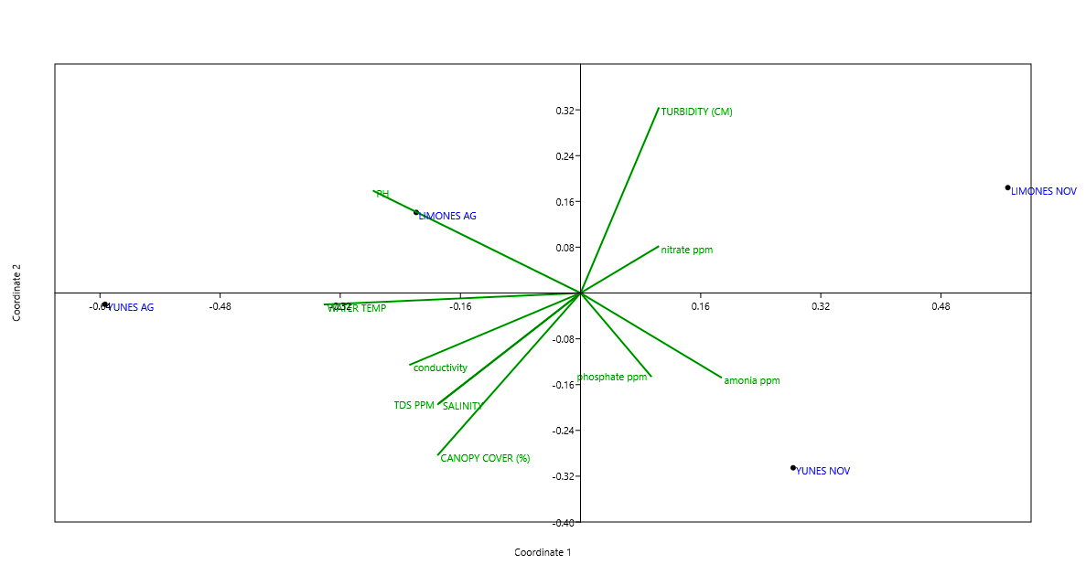
Multivariable Analysis Results
Notes:
We did a multivariable analysis using PAST. According to this, in Limon River, turbidity and nitrate are the most relevant. The same analysis for Yunes River indicated that ammonia and phosphate are the most relevant variables. All those factors are related to agricultural activities by the use of fertilizers and by run-off. We have to mention that it was the raining season in PR.

Slide 8
Results
Notes:
The density of individuals is determined by the amount of macroarthropods per unit area. The area was calculated by measuring a transect of 6.5m and multiplying by the wetted width. Observe that the densities are not very high in these rivers. In August, the highest concentration was observed in the Yunes river. In contrast, in November the highest concentration corresponds to Limon River.

Slide 9
Notes:
This is the total comparison of individuals collected. In August we captured a total of 89 individuals in Limón and 172 individuals in Yunes. If you look at the month of November the abundance was reduced in both rivers. In the Limon river we counted 75% less and Yunes River counted 87% less. Immediately we ask ourselves: Is the agricultural activity the cause of the reduction of these populations?

Slide 10
Notes:
In August, a total of 16 families of benthic macroarthropods were identified for both rivers. The dominant family in Yunes river was Simuliidae and Chironomidae dominated the Limon river.

Slide 11
Notes:
In November 2016, the results were dramatically different. Only 11 families were identified in total. In the Limon river only 4 families for a total of 24 individuals. The dominant family Gerridae. In Río Yunes, a total of 22 individuals were caught. Seven families were identified, being Simuliidae the dominant one.

Slide 12
Families present in both rivers
Yunes River | Families | Limon River
7 | Chironomidae | 28
42 | Heptagenidae | 3
2 | Philopotomidae | 19
1 | Pyralidae | 7
1 | Hydropschidae | 2
22 | Elmidae | 15
Shannon Diversity Index: Yunes 1.51 low and Limon 1.93 low
Notes:
According to Shannon Diversity Index, both rivers presented low diversity.

Slide 13
Conclusions
After studying the measurements of nitrate, phosphate and ammonia concentrations and the diversity of macroarthropods, we can conclude from the multivariable analysis that the increase in the concentrations of these parameters adversely affect diversity. These results validate our hypothesis.
We plan to continue this research in the dry season, considering that there will be less runoff on agricultural land.
Notes:
After studying the measurements of nitrate, phosphate and ammonia concentrations and the diversity of macroarthropods, we can conclude from the multivariable analysis that the increases in the concentrations of these parameters adversely affect diversity. These results validate our hypothesis.
We plan to continue this research in the dry season, considerating that there will be less runoff on agricultural land.

Slide 14
References
Auquilla, R. (2005). Uso del suelo y calidad del agua en quebradas de fincas con sistemas silvopastoriles en la Subcuenca del Río Jabonal, Costa Rica. Centro Agronómico de Investigación y Enseñanza.
Carvacho, C. (2012). Estudio de las comunidades de macroinvertebrados bentónicos y desarrollo de un indice multimétrico para evaluar el estado ecológico de los ríos de la cuenca del Limari en Chile. Universidad de Barcelona
Myer E.& Shaw, R. (2006). The turbidity tube: Simple and Accurate Measurement of Turbidity in the Field. Department of Civil and Environmental E.ngineering Michigan Technological University.
RACC Reference Manual (2016-2017)

Slide 15
Acknowledgements
Mike Winslow, Director VT EPSCoR
Noelia Báez, Prog. Coord. Luquillo LTER Schoolyard
Omar Pérez, PhD. University of PR
Prof. Elliot López, CIAM
Mr. Juan C. Delgado, Land Owner
Notes:
Read

Slide 16
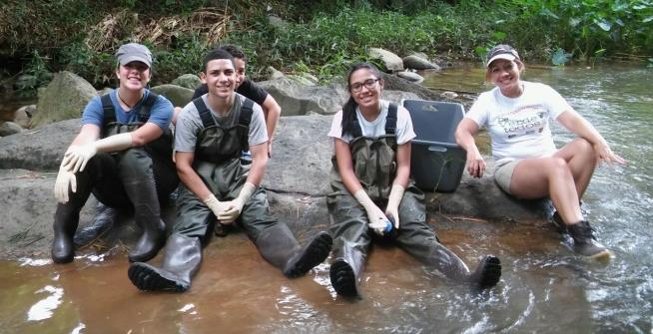
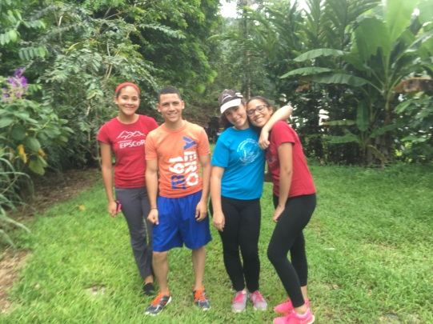
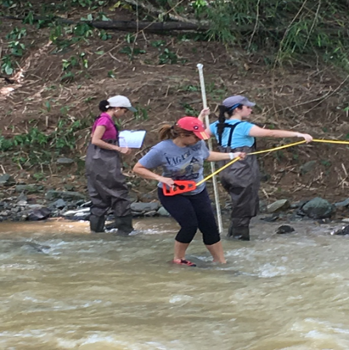
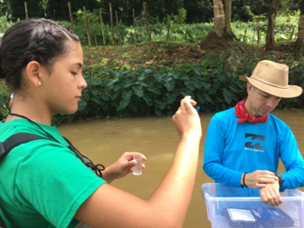
JPL TEAM

