Slide 1
Facing the stream: “ The challenge of evaluating the periphyton growth in flashy rivers”
By:
Tanairí Reyes-Pérez & Francisco Pérez-Vargas
Prof. Elliot López-Machado
Juan Ponce de León HS
Florida, Puerto Rico

Slide 2
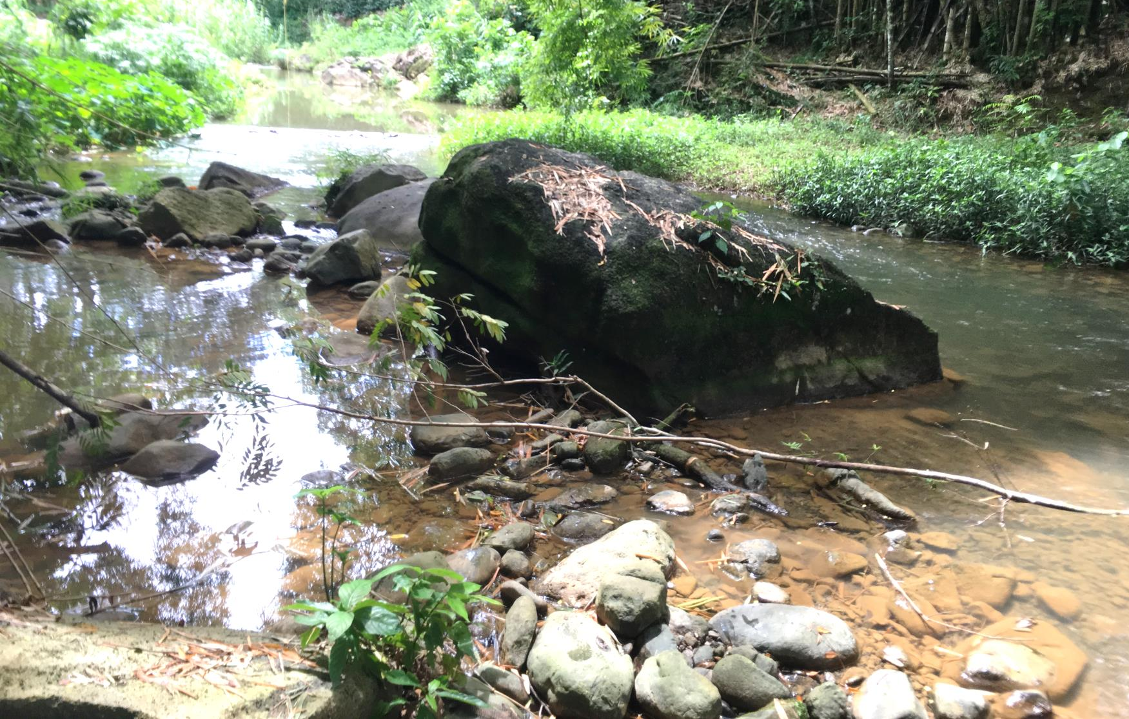
Introduction
Notes:
Yunes river is located in the Rio Grande de Arecibo basin, specifically in the Fronton neighborhood of Ciales, in the northern karst region of PR. The elevations in the area are between 200 and 500 meters. By the orographic effect and heavy rains Yunes can be a flashy river. The study site is surrounded by high agricultural activity. Observe how peaceful it looks.
Rio Yunes, Localizado en la cuenca del Rio Grande de Arecibo, específicamente en el barrio Fronton de pueblo de Ciales, en la zona carsica del norte de PR . Las elevaciones en la zona están entre 200 a 500 metros. Por el efecto orográfico Yunes puede ser un Flashy river con lluvias fuertes. El sitio de estudio está rodeado de alta actividad agrícola.

Slide 3
Study area background
Yunes River
pH=8
WT = 25.03ºC
NO3=6ppm
P04= 0.3ppm
High agricultural activity
NH3=0.27ppm
Notes:
From the parameters presented previously by our colleagues, we analyzed the average values of pH, water temperature, phosphate, nitrate and ammonia. We emphasize that there is high agricultural activity. The results for these parameters should stimulate the growth of algae in the stream. However, we observed few algae on the rocks. We decided to investigate the causes.
De los parámetros presentados anteriormente por nuestros compañeros, analizamos los valores promedios de pH, temperatura del agua, fosfato, nitrato y amoniaco. Enfatizamos en que hay alta actividad agrícola. Las concentraciones medidas favorecen el crecimiento de perifiton en el cuerpo de agua. Sin embargo, observamos pocas algas sobre las rocas. Decidimos investigar las causas.

Slide 4
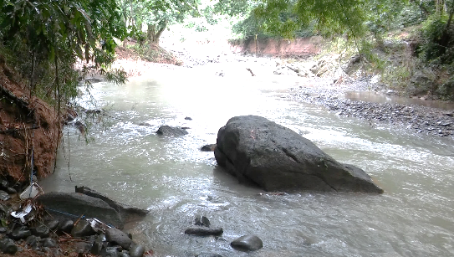
Problem Statement and Hypothesis
PROBLEM
Is the increase in discharge the variable responsible for algae reduction?
Hypothesis
If rains and discharges increase, then algae biomass decreases.
Notes:
Problem is: If physical-chemical parameters values are good for algae growth, what is the effects of increase in discharge? Is the increase in discharge the variable responsible for algae reduction? Our initial hypothesis was: If rains and discharges increase, the algae biomass decreases.
Why do we mean floods? First, because 24 hours before each sampling, heavy rains occurred. Second, this raining season was highly active. In one of the samplings, the river was calm as shown in the first photo and after a few minutes, we left the water because the flow increased surprisingly.
Por qué nos referimos a las crecidas? Primero, Porque 24 horas antes de cada muestreo ocurrieron lluvias fuertes. Segundo, esta raining season estuvo altamente activa. En uno de los muestreos, el rio estaba apacible como se mostraba en la primera foto y luego de unos minutos, nos salimos del agua porque el caudal aumentó sorpresivamente.

Slide 5
Objectives
Measure the primary production of algae
Check if the methodology used is best for flashy rivers
Establish an initial database of periphyton algae growth to compare in dry season.
Determine if changes in discharge minimize or reduce primary production.

Slide 6
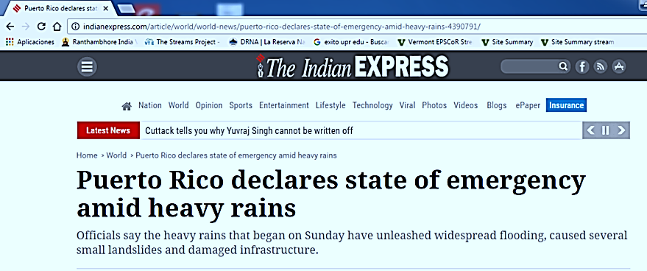
2016
2015 (Drought)
Notes:
These graphs show the precipitation in the town of Ciales. During the months of August to November the year 2015 precipitation was increasing with averages between 100 to 150mm, that was a year of drought. If we compare those months of 2016 we observed that precipitation was greater and more constant.
Estas gráficas muestran la precipitación en el pueblo de Ciales. Durante los meses de Agosto a Noviembre el año 2015 la precipitación fue en aumento con promedios entre los 100 a 150mm, ese fue un año de sequia. Si comparamos esos meses del año 2016 observamos que la precipitacion fué mayor y más constante.

Slide 7
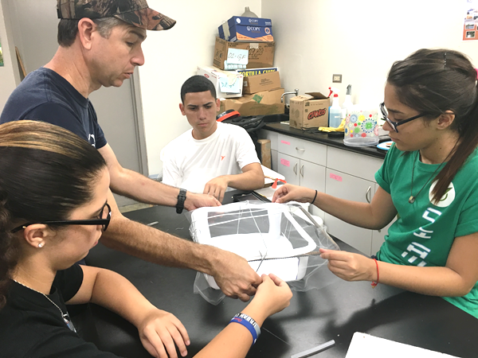
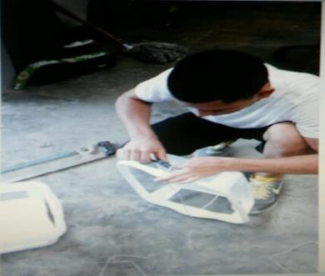
Methodology
Upstream transect
Right bank
Boxes
Downstream transect
Notes:
During the Summer Workshop our team proposed to study the effect of nutrient concentrations on algal biomass. In the original design we used the boxes that are shown on the screen. These are dish drainers of 30cm X 30cm. spaces of 20cm x 8cm were cut. In each box 5 rocks were placed. Then we made the box with tulle cloth to prevent fish and macroinvertebrates from entering. Each box was numbered. The diagram illustrates how they were placed in the river. It is assumed that after 14 days the rocks were collected and in the laboratory the algae were weighed to calculate the biomass from chlorophyll a. The results were then compared with the concentrations of physicochemical parameters to determine the effect of nutrients.

Slide 8
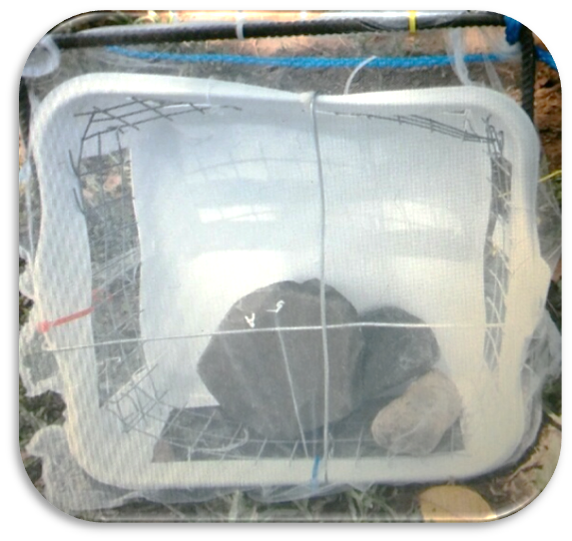
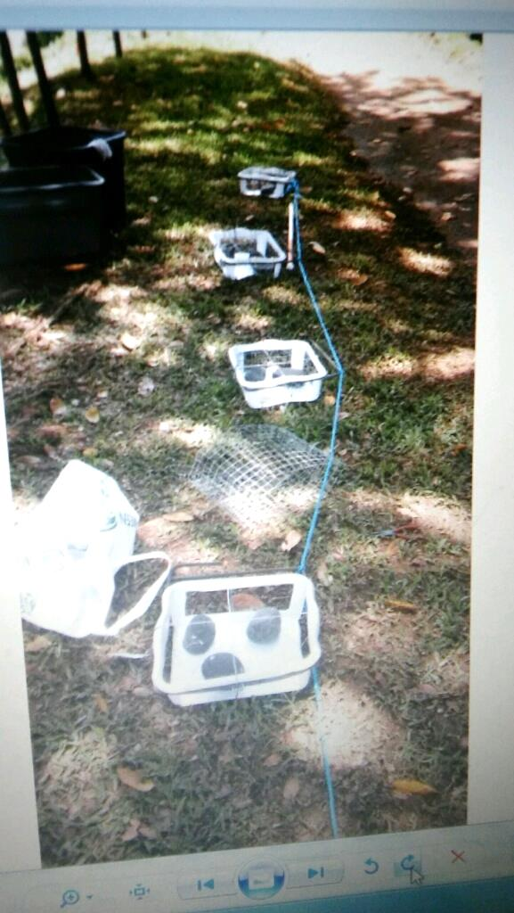
First Round
Notes:
First round. August 2016. We put the boxes in the river, and we left them for two weeks. We knew there were rains.
Colocamos las cajas en el rio, y las dejamos por dos semanas. Teniamos conocimiento de que hubo lluvias.

Slide 9
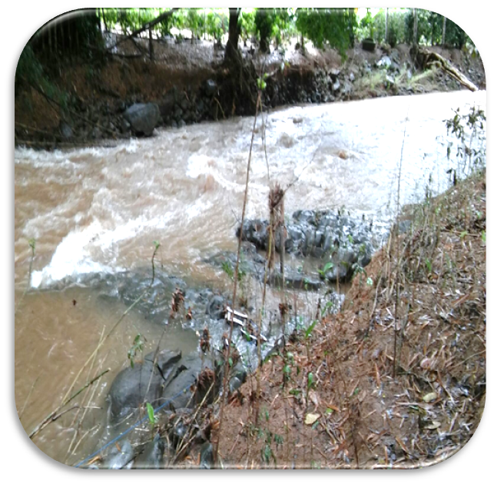
Score: Yunes 1 Team 0
Notes:
Water bursts and floods opened the boxes and we lost more than 60% of the stones. The river gave us a fall. We understood that the river was more active "Flashy". SCORE River 1, team 0.
Golpes de agua, crecidas, abrieron las cajas y perdimos mas del 60% de las piedras . El río nos dio una caída. Comprendimos que el rio estaba mas activo “Flashy”. SCORE El rio 1, team 0.

Slide 10
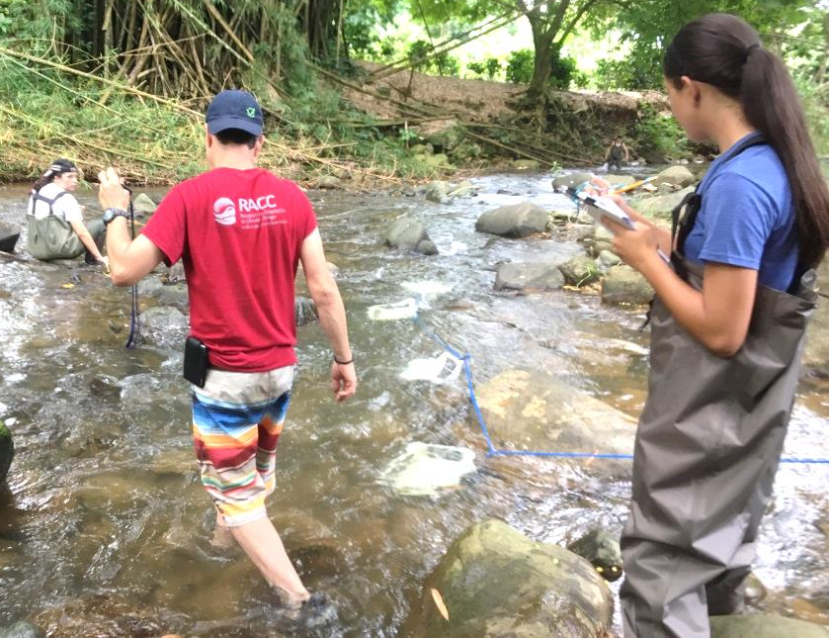
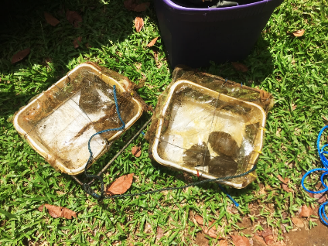
Second Round
Score: Yunes 1| Team 0
Notes:
Second round. October 2016, we modified the boxes reinforcing them with wire mesh of 1.25cm X 1.25cm. According to the forecast, the time for those weeks would be more sunny. After the required time, we return to the river, to find that more than 50% of the sample was lost. We decided to re-evaluate our project.

Slide 11
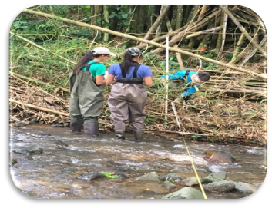
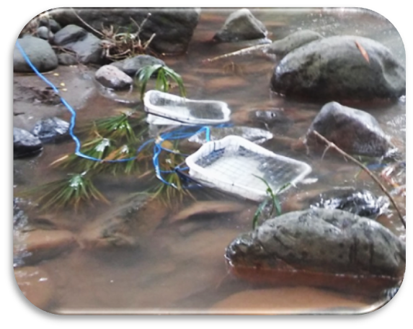
Methodology Revised
Notes:
We review our original problem and our hypothesis. We modified the boxes by placing iron frames and using wire mesh wrapper thicker with spaces of 2.5cm x 2.5cm that allow the passage of organisms into the box. The knots were secured with wire ties. This time we did not use tulle fabric. The river also prepared for the third Round. In November it was the peak month of rains and floods were higher. The island was declared state of emergency.

Slide 12
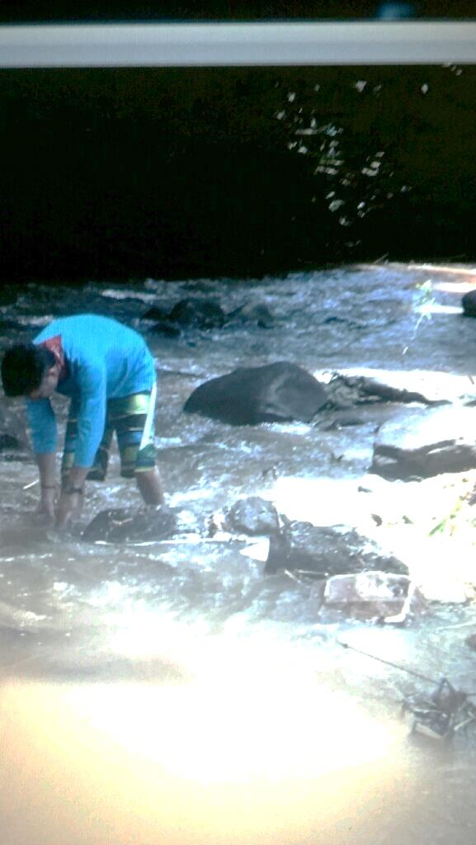
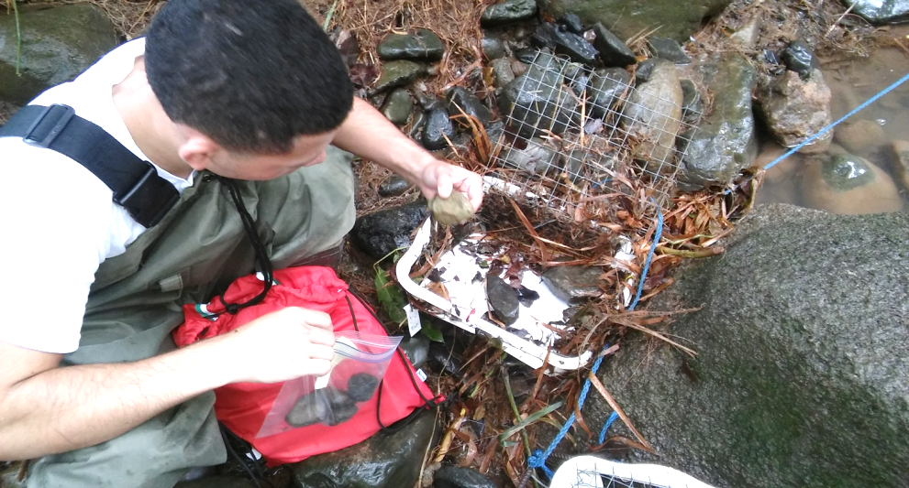
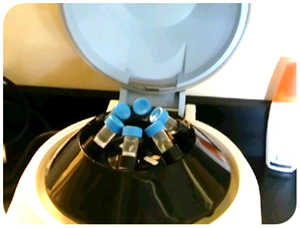
Third Round
We are standing!
Score:
Yunes 0
Team 1
Notes:
Third Round. We get 100% of the boxes and the rocks. We collected the rocks in black bags and kept them in the freezer until they were taken to the laboratory for spectrophotometry tests. In the laboratory with red light, each sample was placed in 20ml of 90% ethanol. They were heated for 60s and placed in a refrigerator for 24 hours. The liquid of each sample was then placed in a centrifuge for 2 minutes. The supernatant of each sample was subjected to spectrophotometry with wavelengths of 665nm and 750nm. This was repeated for the acidified samples using hydrochloric acid (1N). It was calculated in the exposed area of each rock using aluminum foil and comparing the mass of that piece with the mass of an area of aluminum of 9cm2.
Logramos el 100% de las cajas y las rocas. Recogimos las rocas en bolsas negras y se mantuvieron en el congelador hasta llevarlas al laboratorio para las pruebas de espectrofotometria. En el laboratorio con luz roja se colocó cada muestra en 20ml de etanol 90%. Se calentaron por 60s y se colocaron en nevera por 24horas. Luego se colocó el líquido de cada muestra en una centrífuga pr 2 minutos. El sobrenadante de cada muestra se sometió a espectrofotometria con lasgos de honda de 665nm y 750nm. Esto se repitió para las muestras acidificadas utilizando ácido clorhidrico (1N). Se calculó en área expuesta de cada roca utilizando papel de aluminio y comparando la masa de ese pedazo con la masa de un area de aluminio de 9cm2.

Slide 13
Results
Notes:
Banks width and wetted width. As rains increase in the area, discharge increase and flooded the banks. Changes in banks increase from 11 to 20 meters in contrast with the wetted width that increase only from 11 to 14meters. Discharge was less than 1 cubic meter until October but increase to 2.5 cubic meters in November. Notice how weather change in that period.

Slide 14
Biomass results
AVE = 1268.40µg/L
Notes:
Our biomass results based on chlorophyll a, indicate an average of 1268.4μg / m2. This low productivity was compared with studies conducted at El Yunque Rain Forest.
Nuestros resultados de biomasa basados Clorofila a, indican un promedio de 1268.4µg/m2. Esta baja productividad se comparó con los estudios realizados en El Yunque Rain Forest.

Slide 15
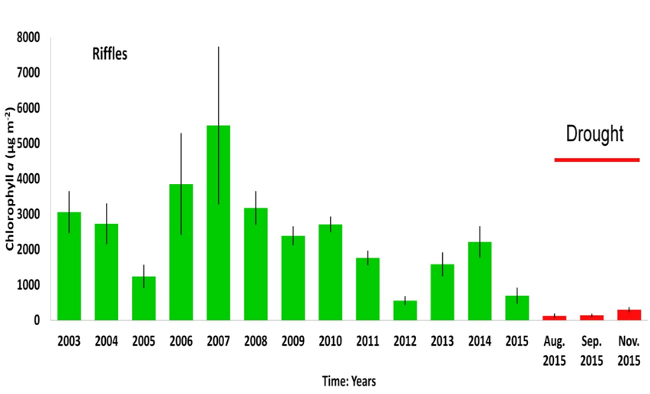
A comparison with a stream at El Yunque Rain Forest Drastic changes in the concentrations of chlorophyll a previous and during the drought were observed in riffles micro-habitats
2016 Yunes River Average: 1268.4
Omar Pérez-Reyes¹, Todd A. Crowl², Alan P. Covich³, Alonso Ramirez¹ & William McDowell⁴
Notes:
In 2015 scientists studied the Quebrada Prieta in the Rain Forest Yunque. Observes that the average production of chlorophyll a during the months of drought from August to November did not reach 1000μg / m2. Drought dramatically reduced algae production. However, at our research site that algae production was affected by rains that make the river more flashy and the abrasive action of the sediments washed away reduced the amount of algae in the rocks.

Slide 16
Conclusions
In flashy rivers nutrient parameters may be optimal for algae growth, but changes in discharges reduce algae growth.
The original methodology used was not appropriate.
The initial data bank was established to compare periphyton growth with the dry season 2017.
Notes:
Due to the accidents caused by the currents, we recognize that our work has few data. However, we documented that the peaceful river recovering from the drought of 2015 can be transformed into a flashy river. The documented chemical parameters are favorable for algae, but sediment discharges have had abrasive and cumulative effects that prevent the best development of algae. With this experience the first data bank is established to continue our research with the intention of comparing the growth of algae in the dry season from March to May 2016.
Debido a los accidentes ocasionados por las corrientes, reconocemos que nuestro trabajo tiene pocos datos. Sin embargo, documentamos que a el apacible rio que se recuperaba de la sequia del 2015 se puede transformar en un rio flashy. Los parametros químicos documentados son favorables para las algas, pero las descargas de sedimento han tenido efectos abrasivos y acumulativos que impiden el mejor desarrollo de las algas. Con esta experiencia se establece el primer banco de datos para continuar nuestra investigación con la intensión de comparar el crecimiento de algas en la estación seca de marzo a mayo 2016.

Slide 17
Ready for next round!
Thanks for your attention.
Notes:
Now we are ready for next round!

Slide 18
References
Ciales (00638) Monthly Climate Average, Puerto Rico. https://www.worldweatheronline.com/v2/weather-averages.aspx?q=00638
Droughts and macroinvertebrate community responses in tropical streams in Puerto Rico. Omar Pérez-Reyes1, Todd A. Crowl2, Alan P. Covich3, Alonso Ramirez1 & William McDowell4
EPA 600/R-06/126 October 2006 www.epa.gov. Field Operations Manual for Assessing the Hydrologic Permanence and Ecological Condition of Headwater Streams.
Hernandez, Aguirre and Palacio. (2011). Rev. Fac. Ing. Univ. Antioquia N.° 60 pp. 159-169. Septiembre, 2011. Relationship between chlorophyll a pigment and algal geometric biovolume determination in a floodplain lake (Ciénaga Ayapel, Córdoba-Colombia).
RACC Reference Manual 2016-2017
Sprague, L. and Zuellig, R. (2006). Physical, chemicals, and biological characteristics of streams in urbanizing areas near Denver, Colorado. US Geological Survey, Denver-Colorado
Trinidad, Matias and Quiles (2016). Effects of agricultural activities on physico-chemical parameters and benthic macroarthropods. EPSCoR Stream Project

Slide 19
Acknowledgments
Mr. Juan Carlos Delgado – Land Owner
Omar Pérez, PhD. University of PR
Prof. Rose Trinidad & team members JPL- HS
Noelia Báez, Luquillo LTER Schoolyard Coordinator
Alonso Ramírez, PhD. University of PR
ESPCoR , VT

Slide 20
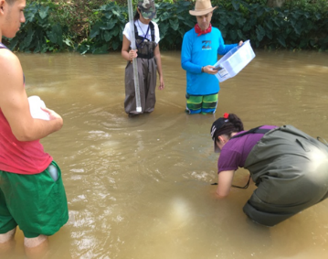
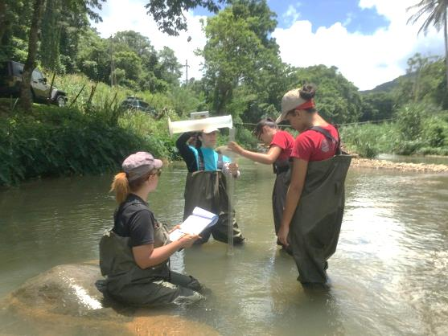
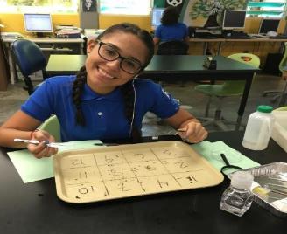
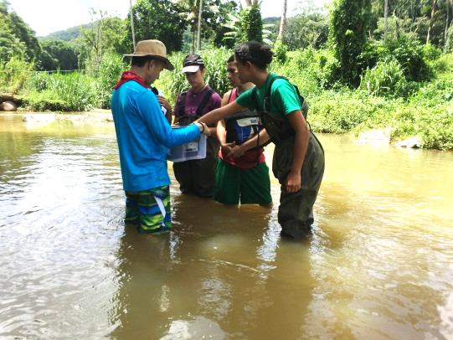
JPL ELLIOT’S TEAM

