Slide 1
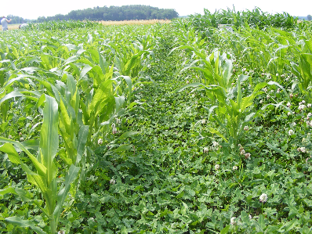
Evaluating Cover Crops’ Ability to Reduce Phosphorus Runoff through Meta-Analysis
Richard Moyer & Laura Albino Díaz
March 2017
Clover cover crop - Dave Robison

Slide 2
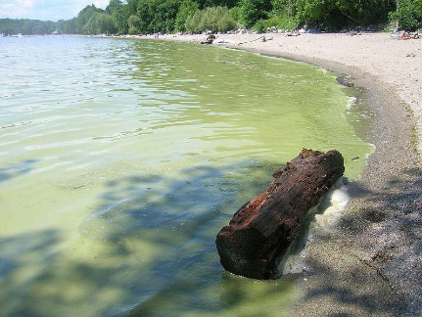
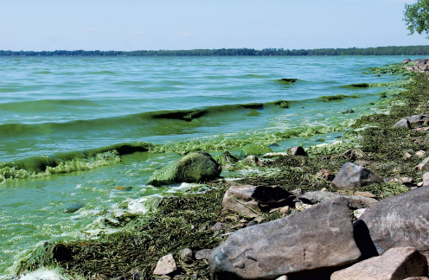
Introduction
Blue-green algae - Vermont Department of Health
Toxic Algae in Missisquoi Bay - Seven Days

Slide 3
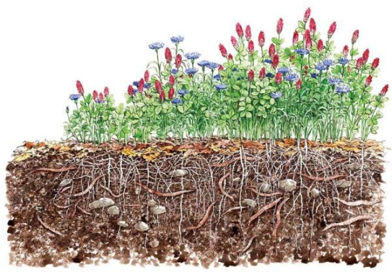
Cover Crops
Enhance soil structure
Increase soil organic matter
Improve pest management
Improve environmental quality
Cover crops - Elaine Sears

Slide 4
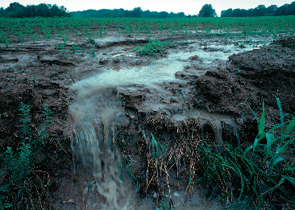
Research Question & Purpose
What is the efficacy of cover crops to reduce phosphorus loss from agricultural soil?
Important because…
P is limiting factor for some watersheds EG. Lake Champlain
Eutrophication is a growing problem
Limited resources exist to combat it
Agricultural runoff - Pennsylvania State University

Slide 5
Methods
Conduct literature review
Record relevant study data points
Apply statistical analysis
Calculate P reduction efficacy

Slide 6
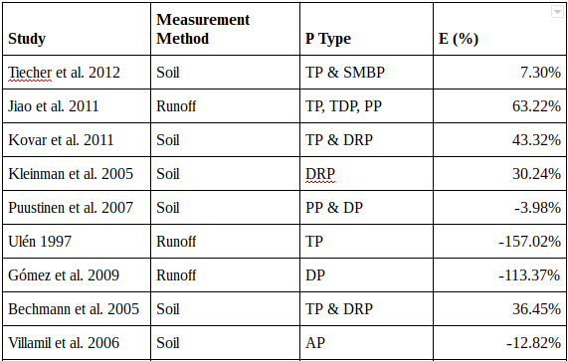
Efficacies varied greatly

Slide 7
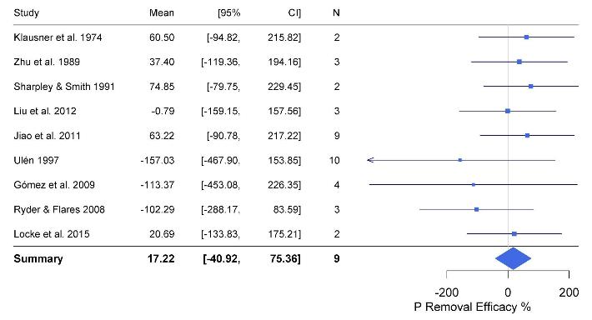
Runoff Results

Slide 8
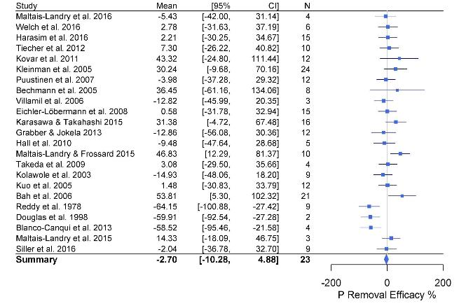
Soil Results

Slide 9
Discussion
Effect sizes indicate that cover crops may reduce P loss
However, results are not statistically significant
Extreme weather events or increased rainfall may have affected studies in which P loss increased
Soil may reach P saturation after many seasons
Total P loss does not necessarily indicate increased eutrophication potential
Cover crops may reduce algae by utilizing bioavailable inorganic P

Slide 10
Acknowledgements
Many thanks to…
Dr. Yushiou Tsai
Q3 Mentors
Q3 Interns
Funding for this research is provided by NSF grant EPS-1101317.

Slide 11
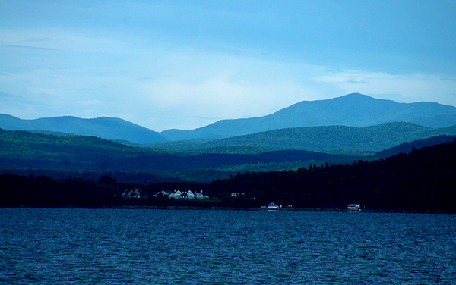
Questions
Lake Champlain - Mark Holden

Slide 12
Literature Cited
Borenstein, M., Hedges, L.V., Higgins, J.P., & Rothstein, H.R. (2010). A basic introduction to fixed-effect and random-effects models for meta-analysis. Wiley Online Library, 97-111.
Kaspar, T.C., Kladivko, E.J., Singer, J.W., Morse, S., & Mutch, D. (2006, August 25). Potential and limitations of cover crops, living mulches, and perennials to reduce nutrient losses to water sources from agricultural fields. Environmental Protection Agency. Retrieved July 22, 2016, from https://www.epa.gov/sites/production/files/2015-07/documents/2006_8_25_msbasin_10covercrops.pdf.
Natural Resource Conservation Service (NRCS). (2010 September). Cover Crop Conservation Practice Standard. Retrieved July 22, 2016 from http://www.nrcs.usda.gov/Internet/FSE_DOCUMENTS/nrcs143_025656.pdf
North Carolina Forest Service. What are BMPs? (2014, May 13). Retrieved July 21, 2016, from http://www.ncforestservice.gov/water_quality/what_are_bmps.htm.
Schechter, S. P., Canfield, T. J., &amp; Mayer, P. M. (2013). A Meta-Analysis of Phosphorus Attenuation in Best Management Practices (BMP) and Low Impact Development (LID) Practices in Urban and Agricultural Areas. Ada: United States Environmental Protection Agency
Sharma, S., Gray, D., Read, J., O’Reilly, C., Schneider, P., Qudrat, A., … Hook, S. (2015). A global database of lake surface temperatures collected by in situ and satellite methods from 1985–2009. Scientific Data, 2, 150008–150008.
Sustainable Agriculture Research & Education (SARE). Cover Crops. (2012). Retrieved July 21, 2016, from http://www.sare.org/Learning-Center/Topic-Rooms/Cover-Crops.

